Slide 1
Micro Credit Defaulters
Presented by :-
Asheem Siwach

Slide 2
Introduction
We are working with client that is in Telecom Industry. They are a fixed wireless telecommunications network provider. They have launched various products and have developed its business and organization based on the budget operator model, offering better products at Lower Prices to all value conscious customers through a strategy of disruptive innovation that focuses on the subscriber.
They are collaborating with an MFI to provide micro-credit on mobile balances to be paid back in 5 days. The Consumer is believed to be defaulter if he deviates from the path of paying back the loaned amount within the time duration of 5 days. For the loan amount of 5 (in Indonesian Rupiah), payback amount should be 6 (in Indonesian Rupiah), while, for the loan amount of 10 (in Indonesian Rupiah), the payback amount should be 12 (in Indonesian Rupiah).
The objective is to study the behaviour of users who are going to default and also making a machine learning model using the dataset provided by the client which can help in predicting the new Users behaviour.

Slide 3

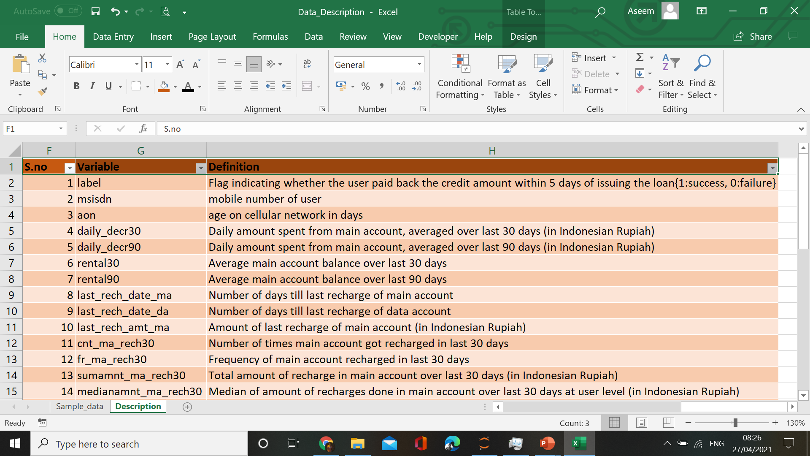
Attributes Information

Slide 4
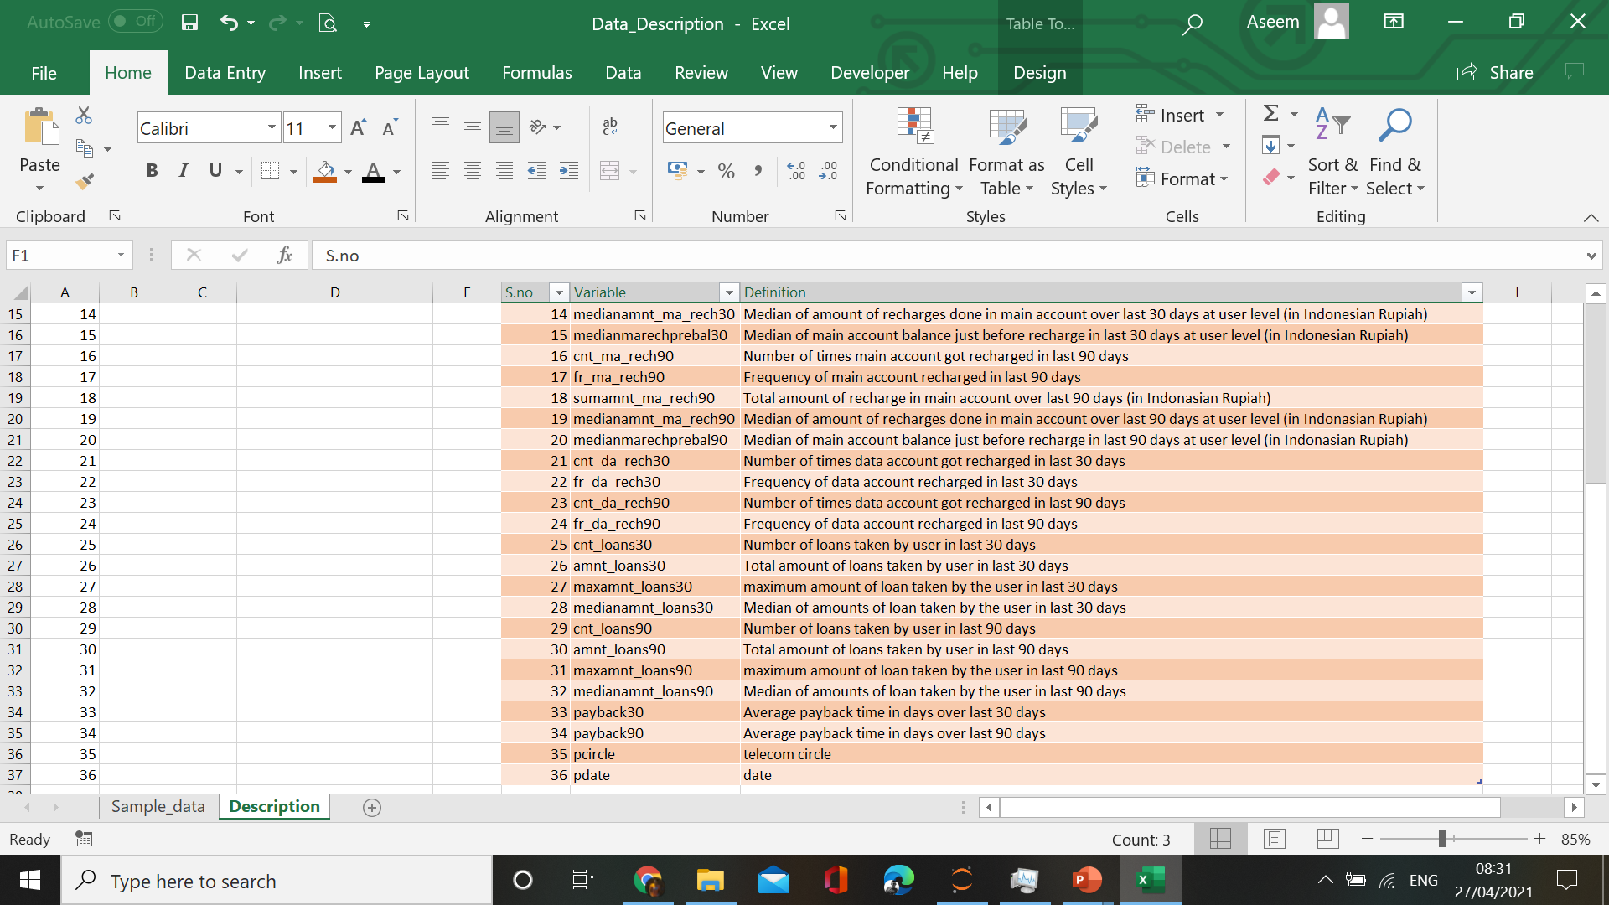

Slide 5
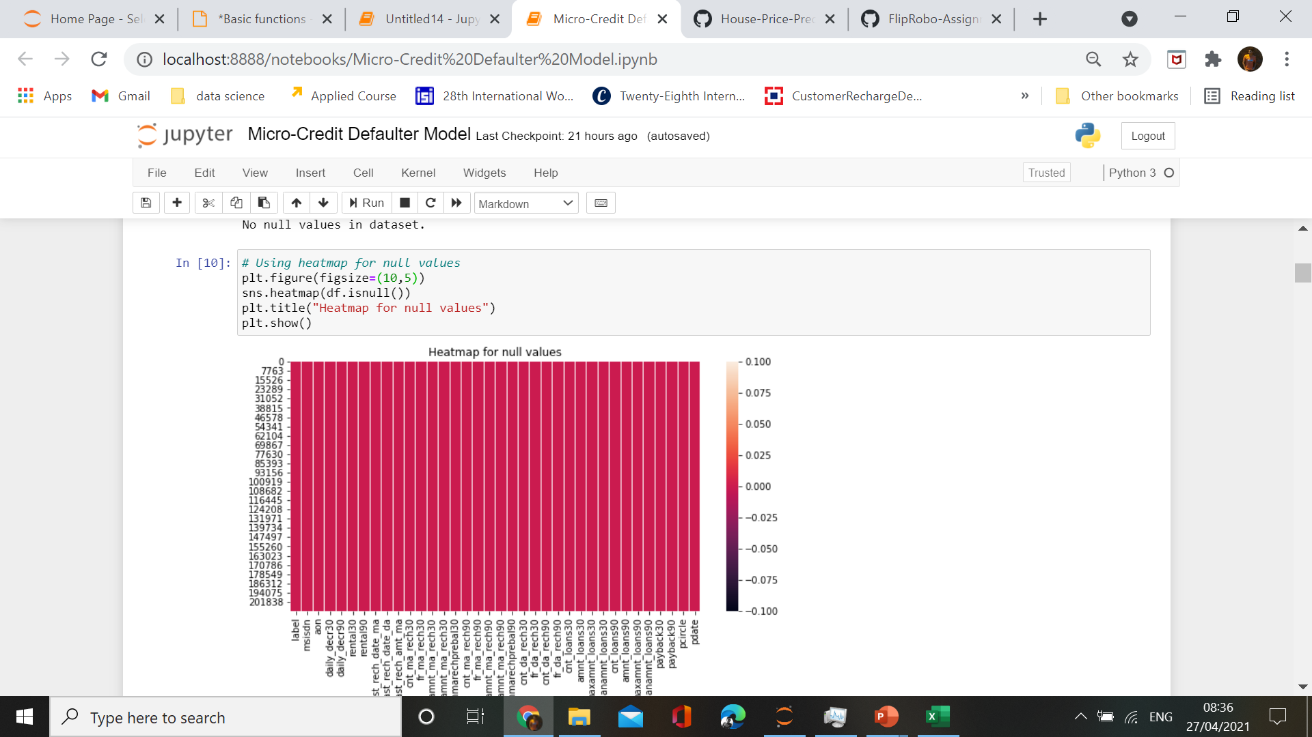
Exploratory Data Analysis

Slide 6
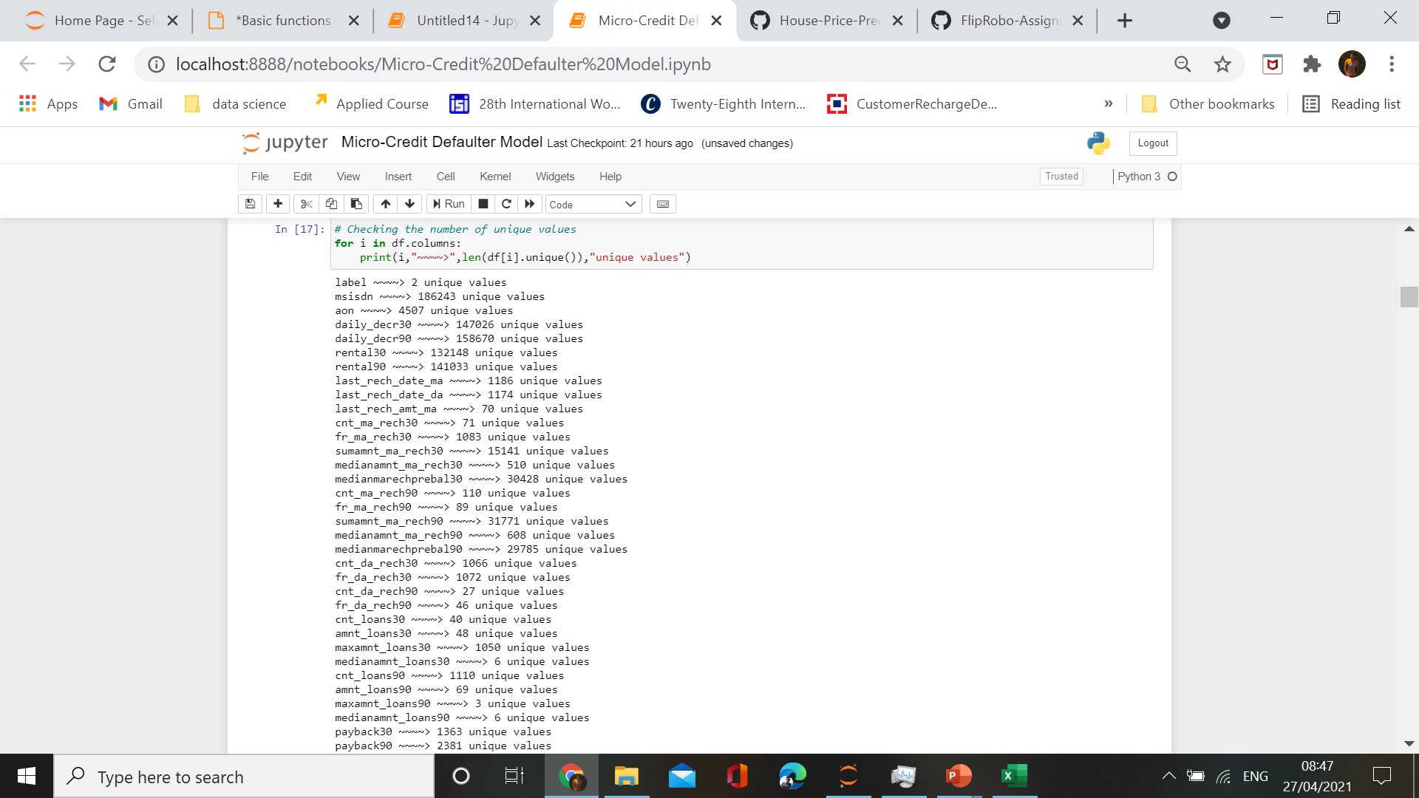
Checking unique values

Slide 7
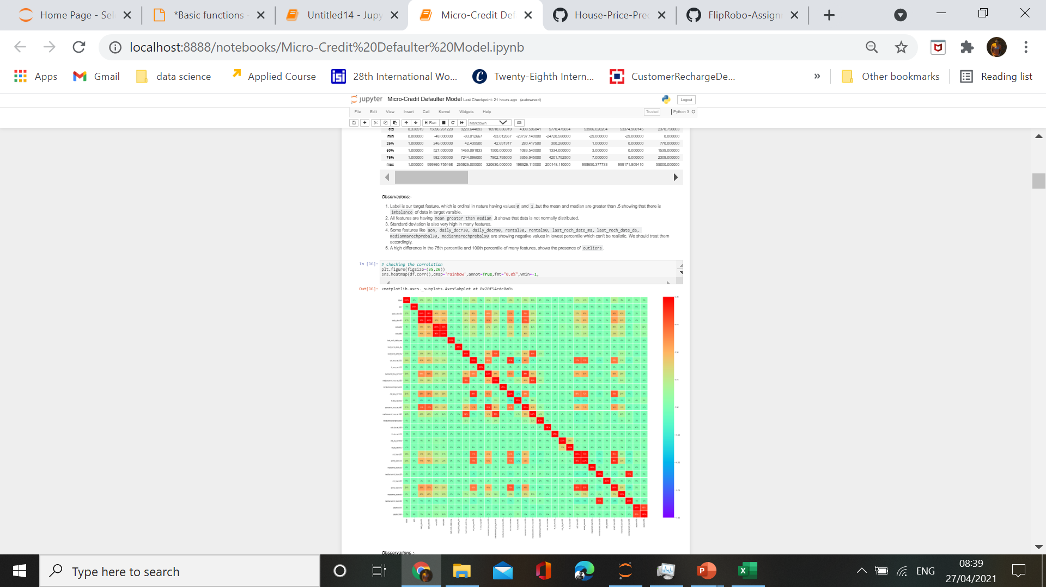
Heatmap showing correlation

Slide 8

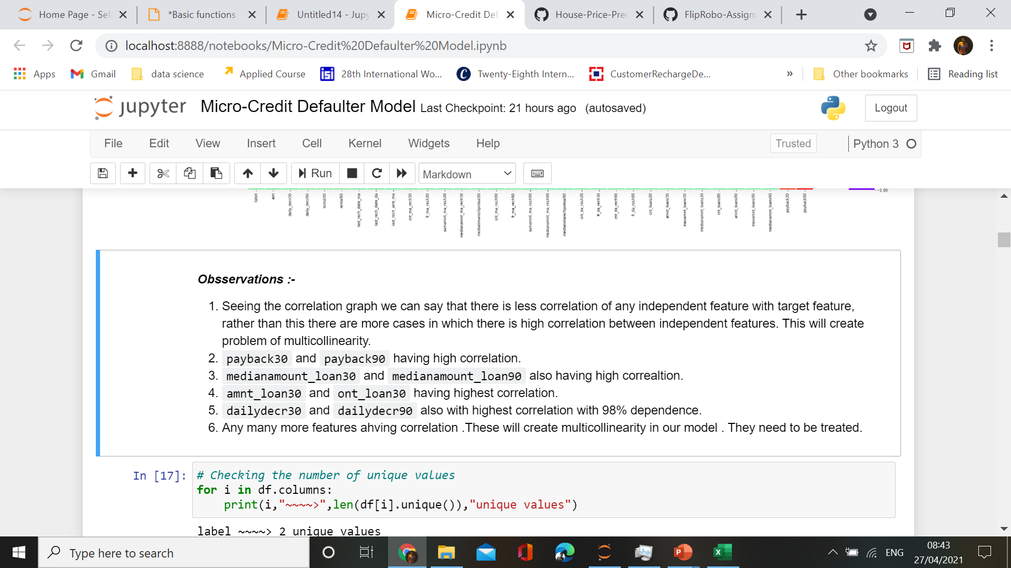
Heatmap observations

Slide 9

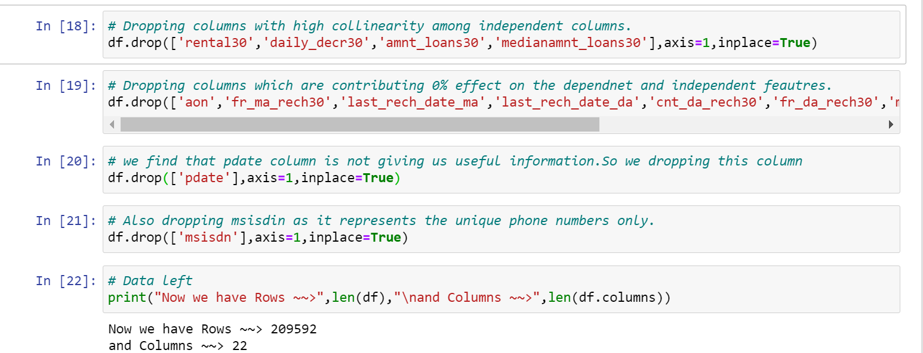
Data Preprocessing

Slide 10
Data Visualization

Slide 11
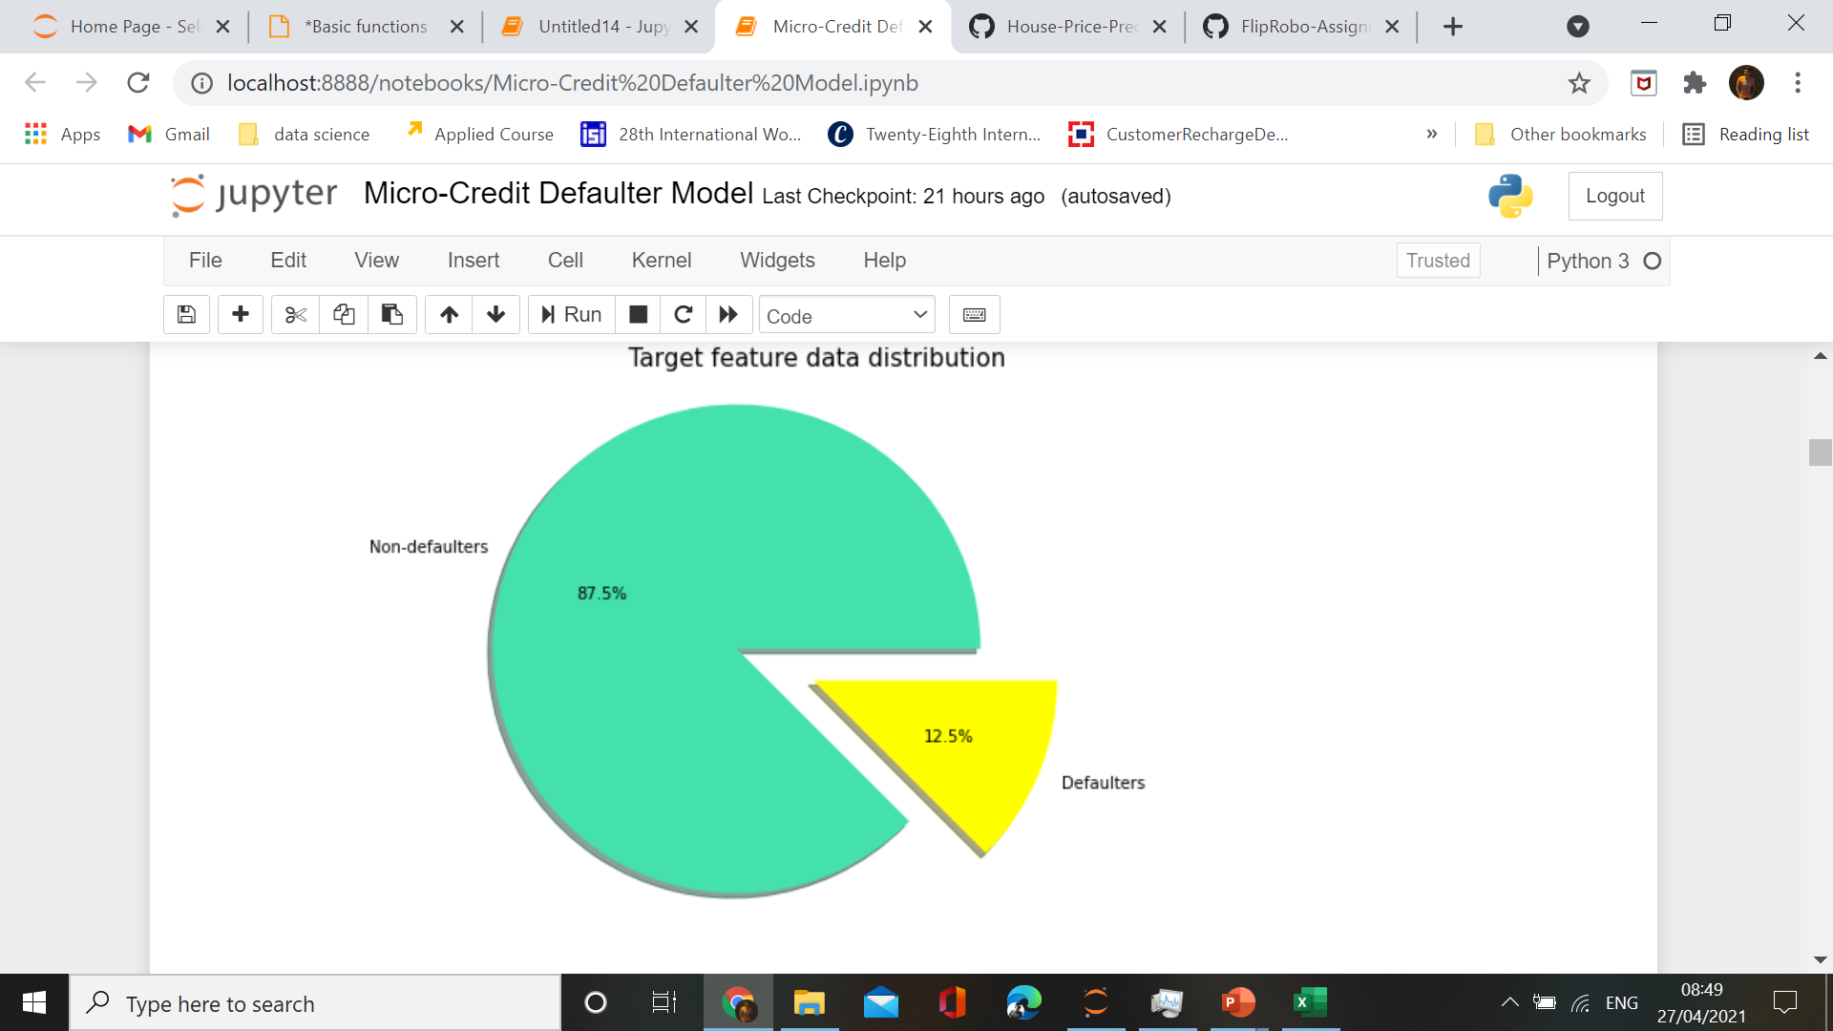

Slide 12
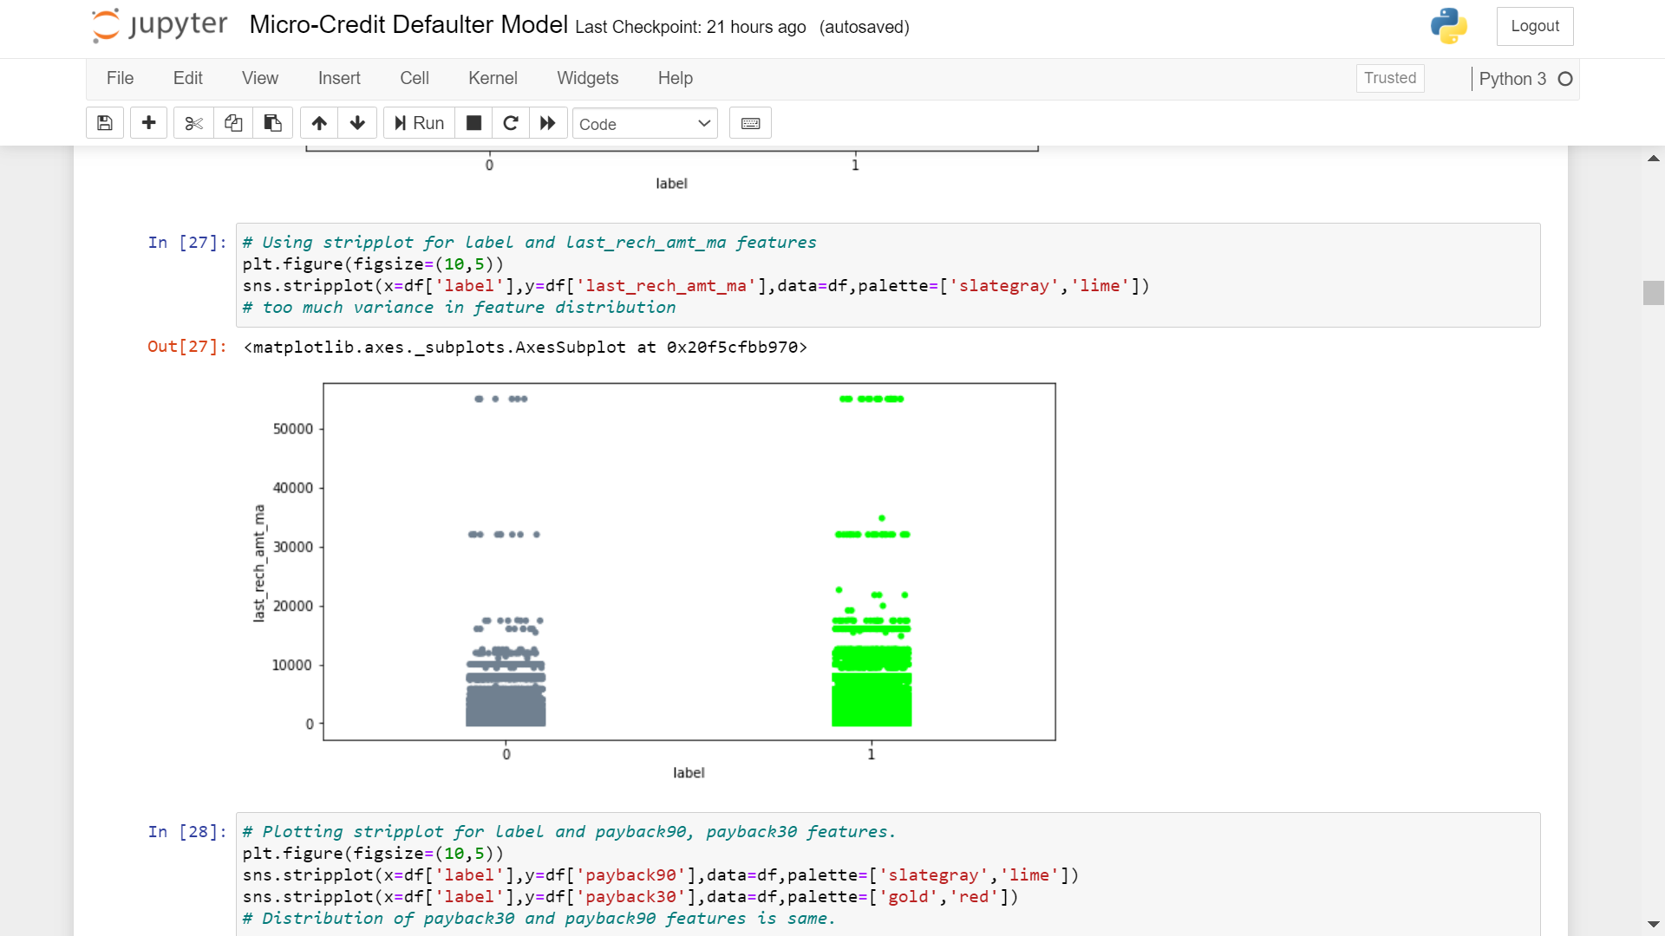

Slide 13
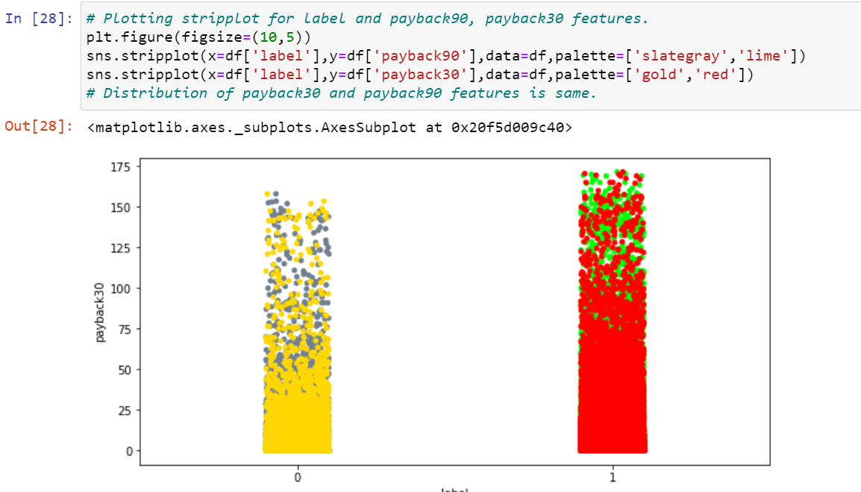

Slide 14
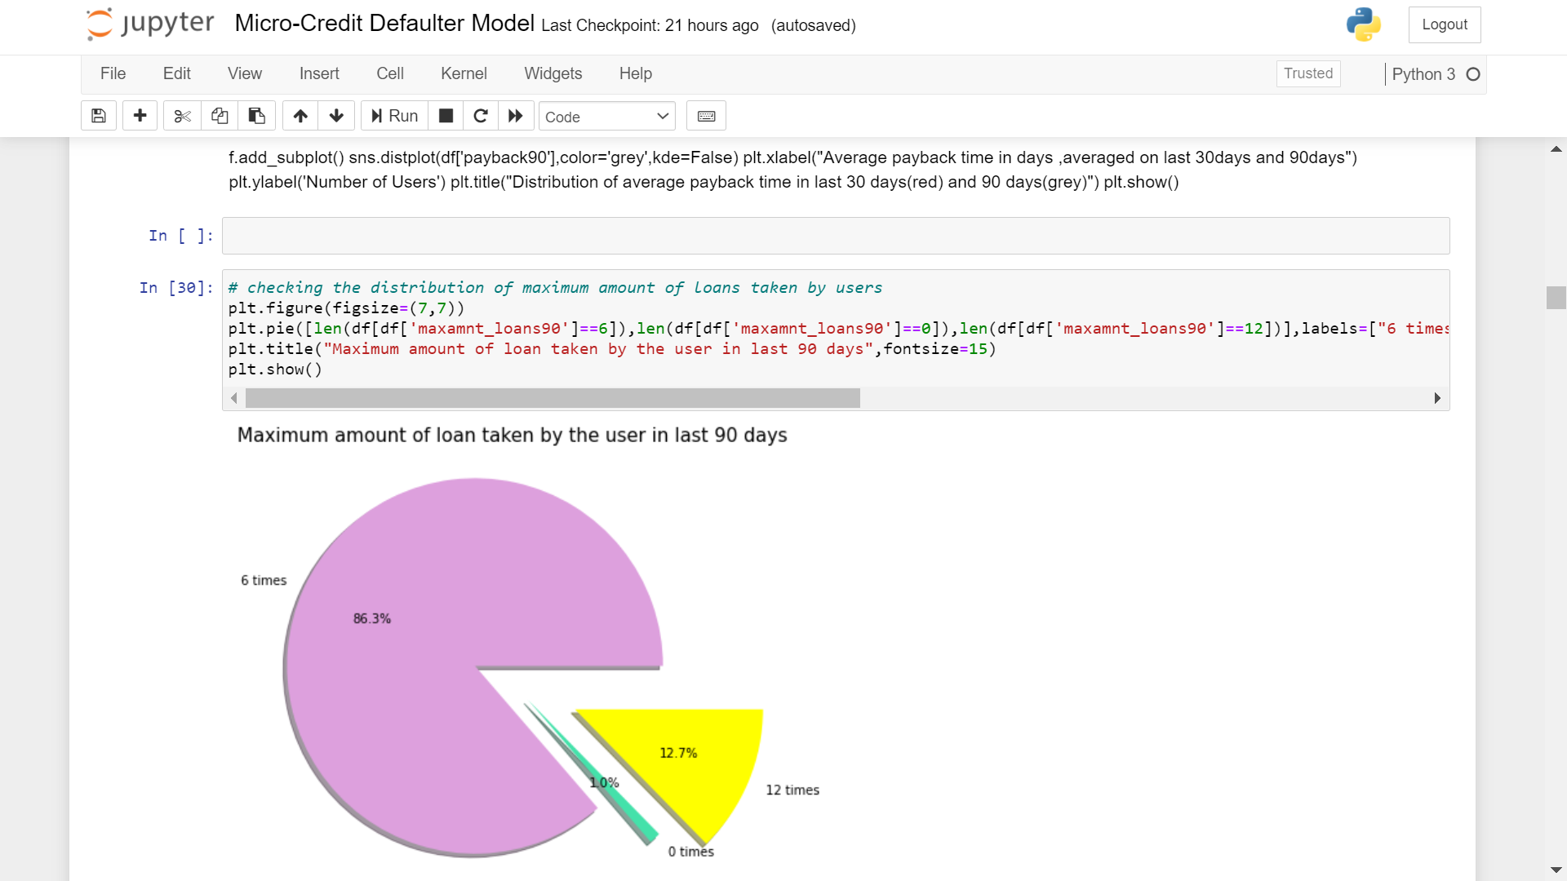

Slide 15
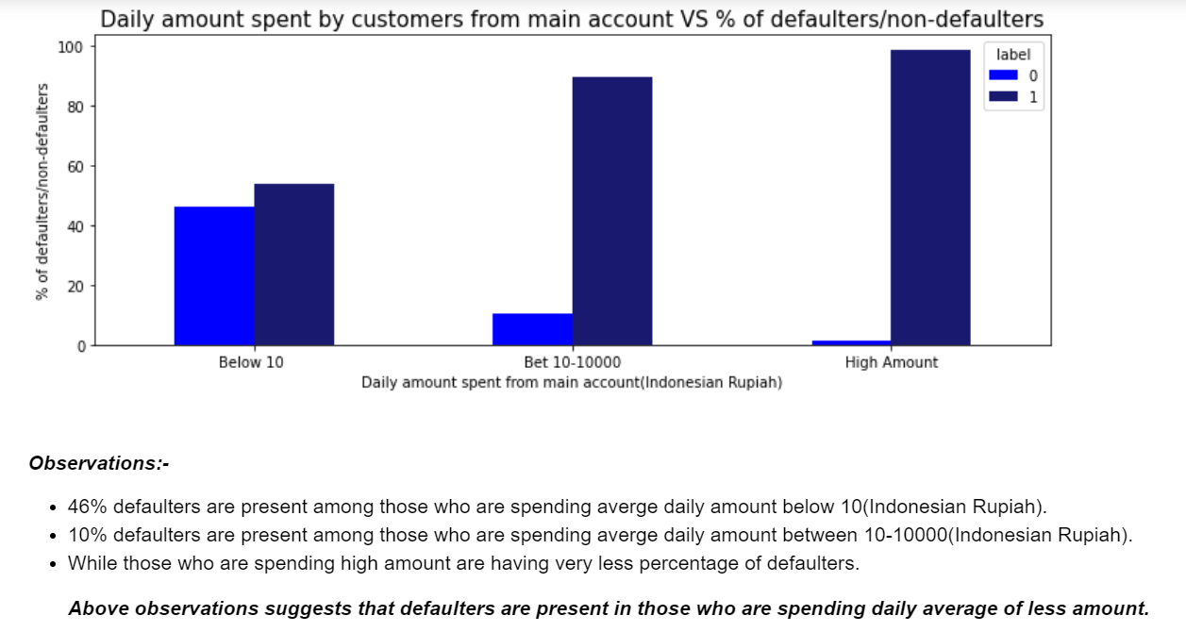

Slide 16
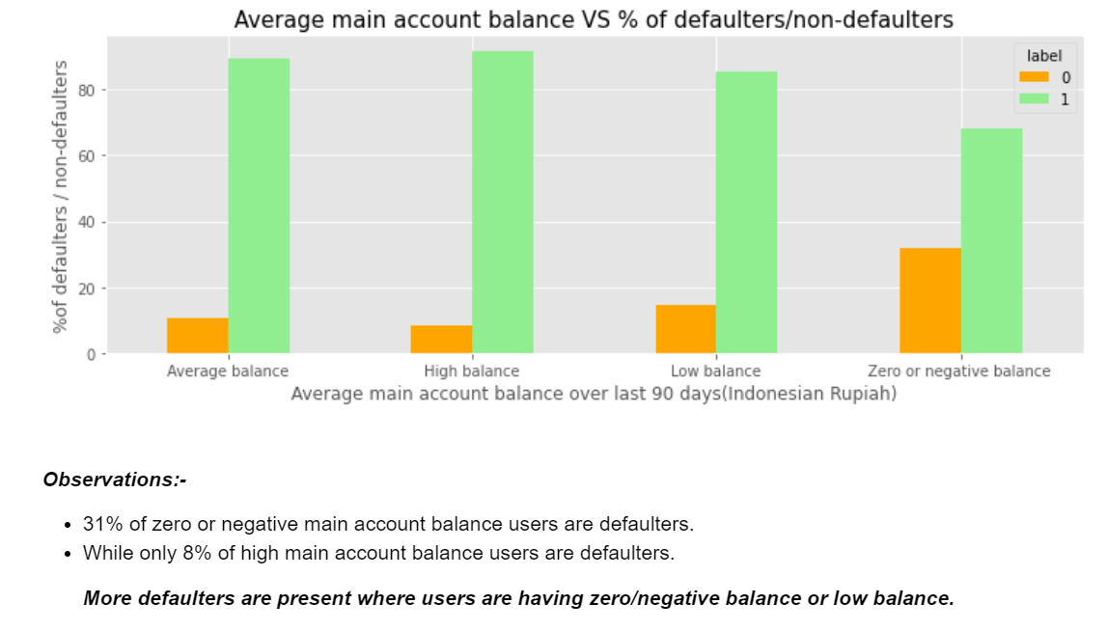

Slide 17
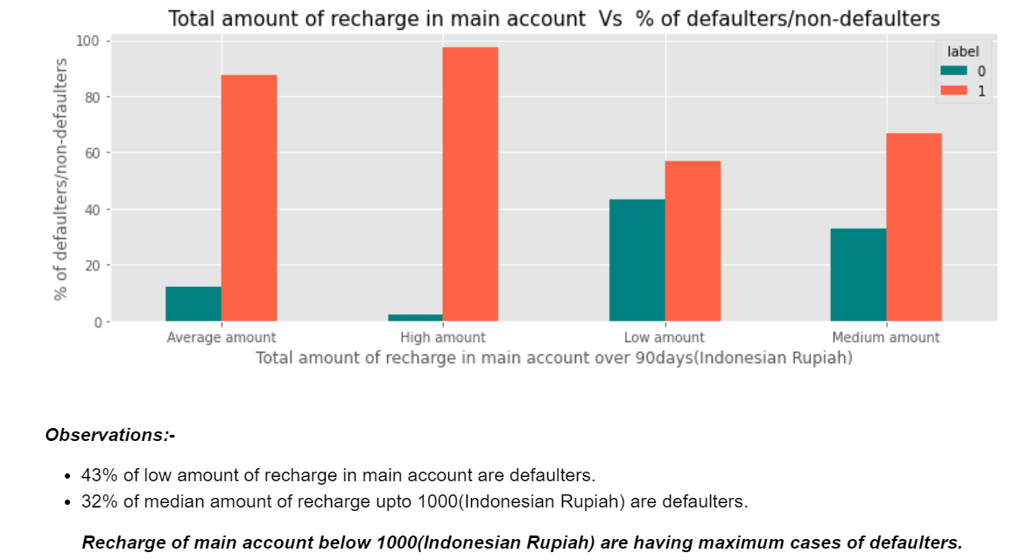

Slide 18
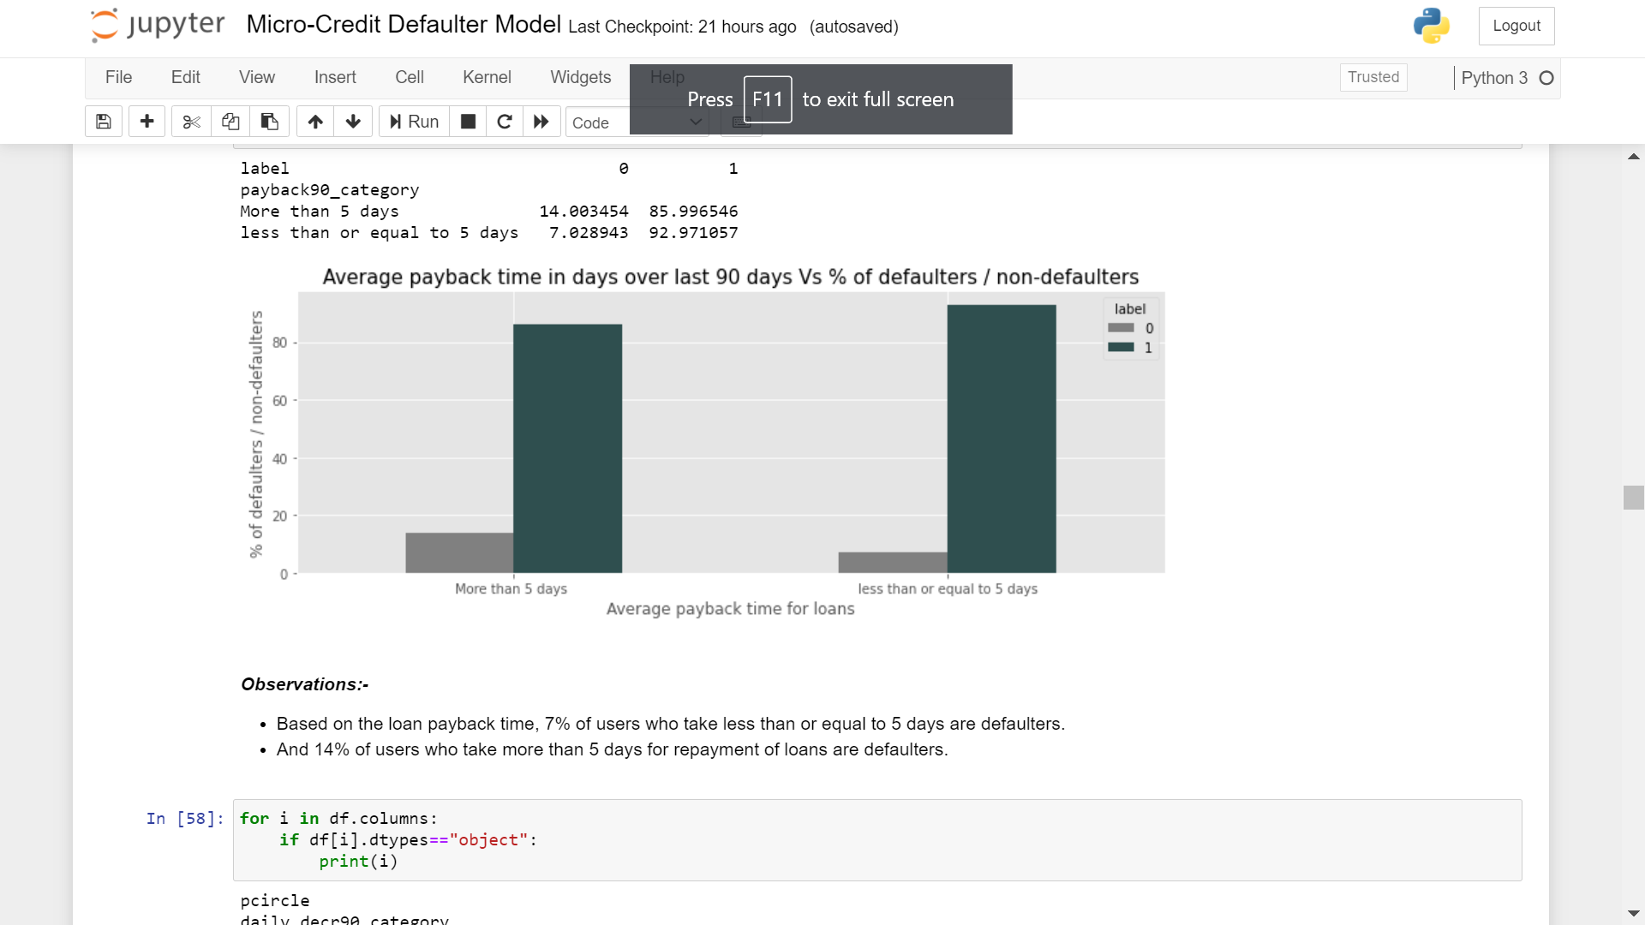

Slide 19
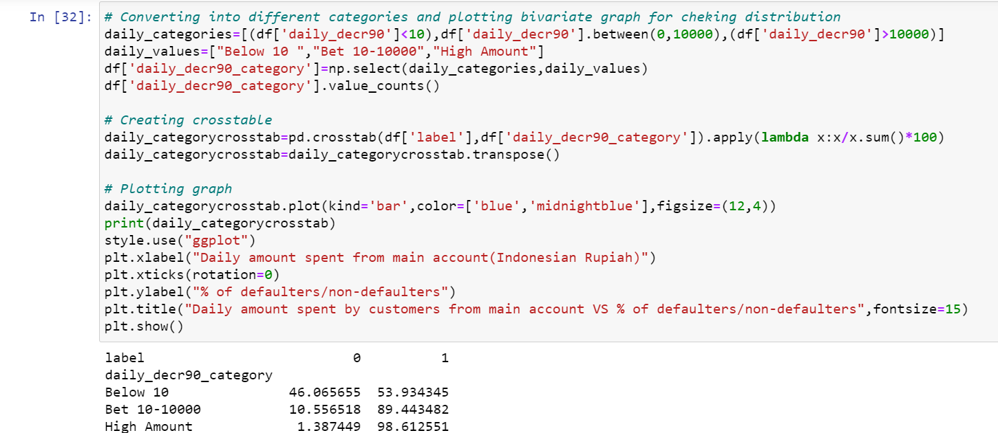
Feature - Engineering

Slide 20
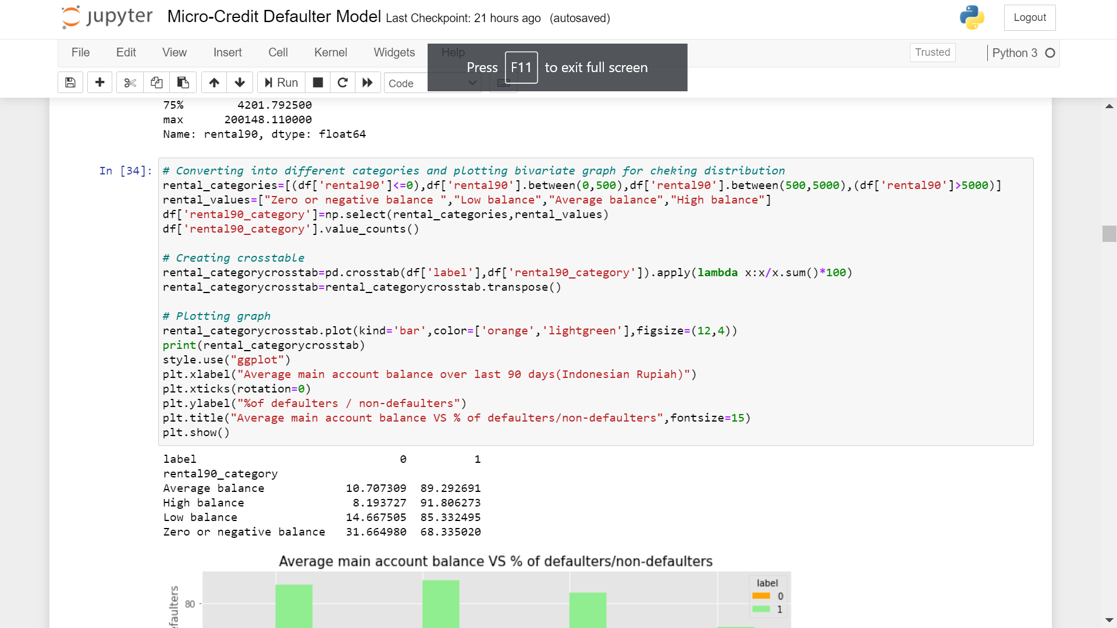

Slide 21
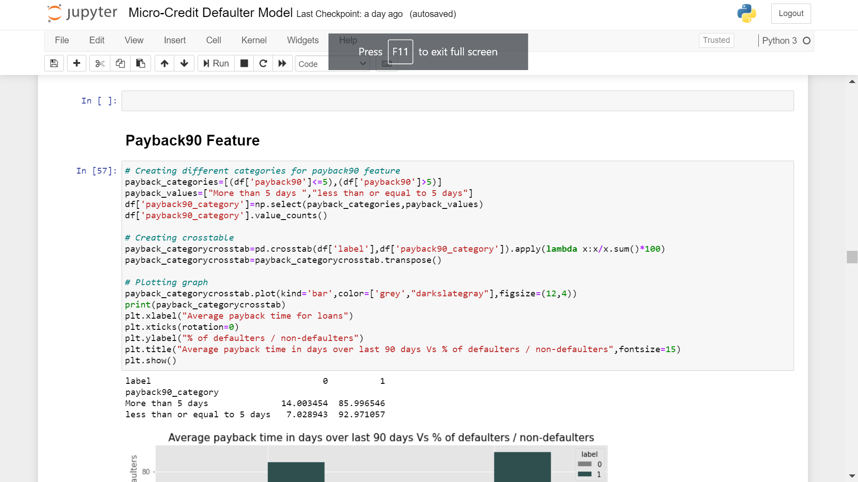

Slide 22
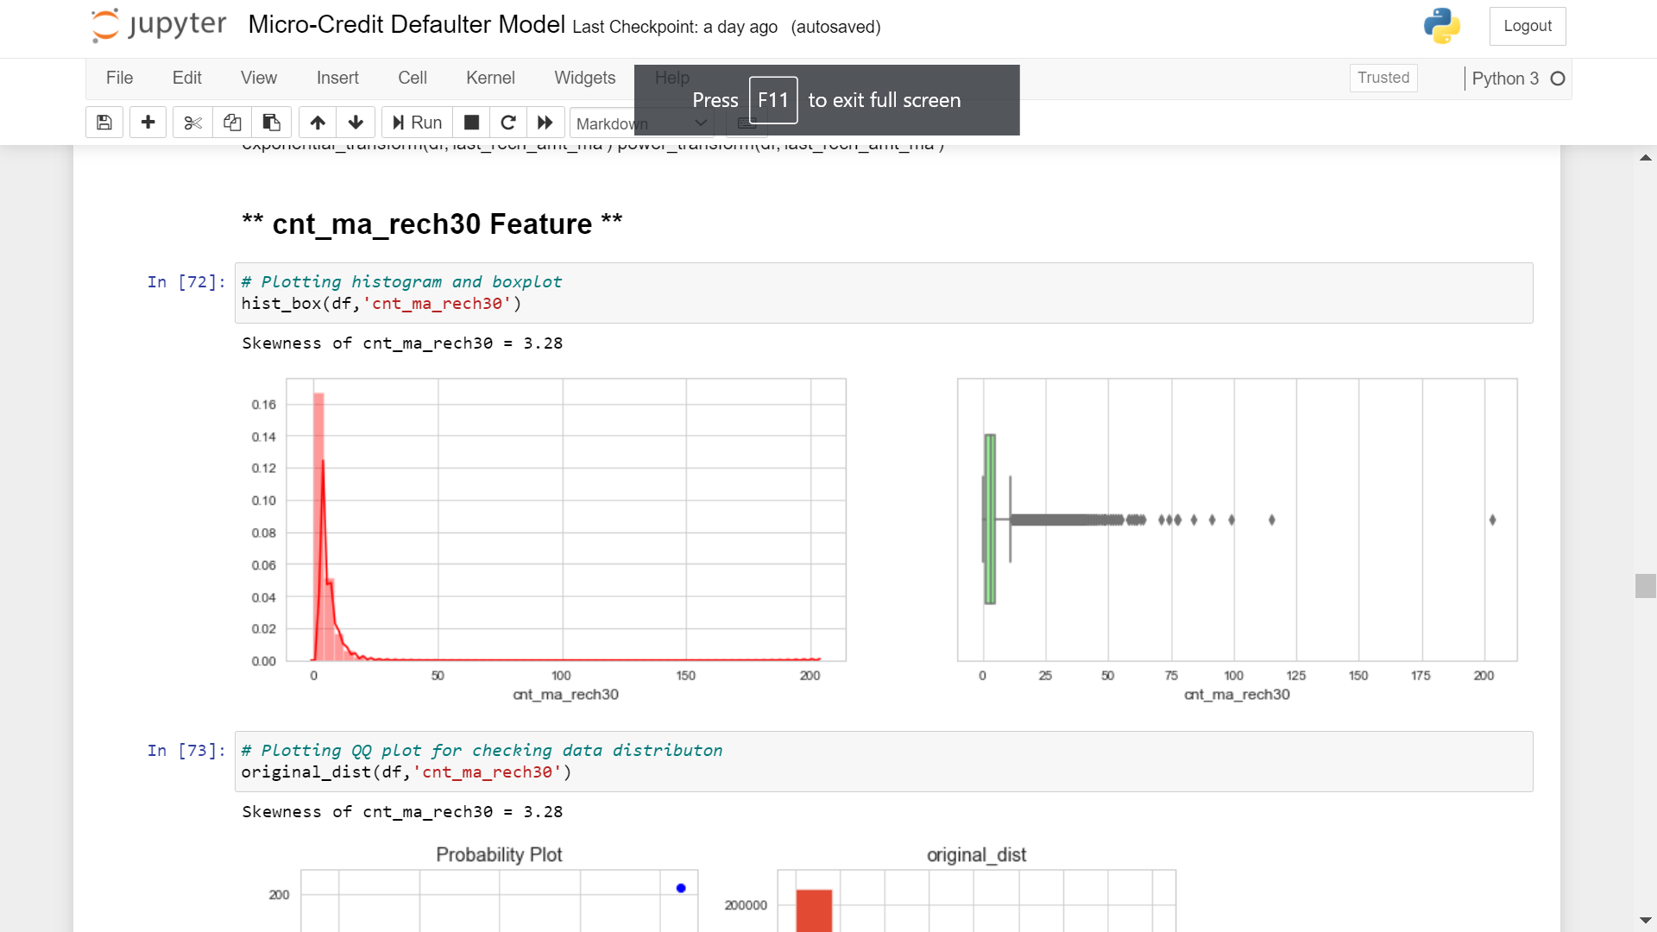
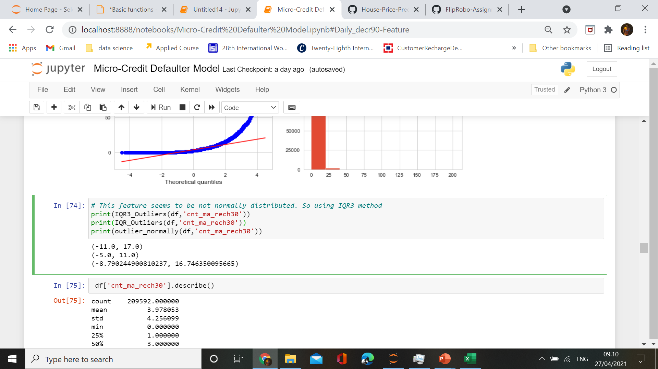
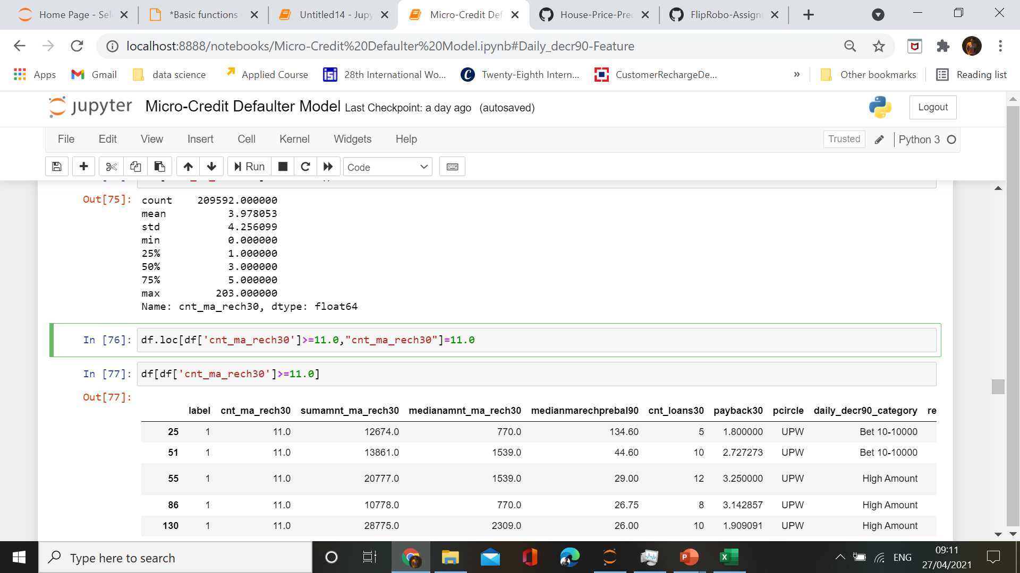
Data – Cleaning(Handling Outliers)

Slide 23
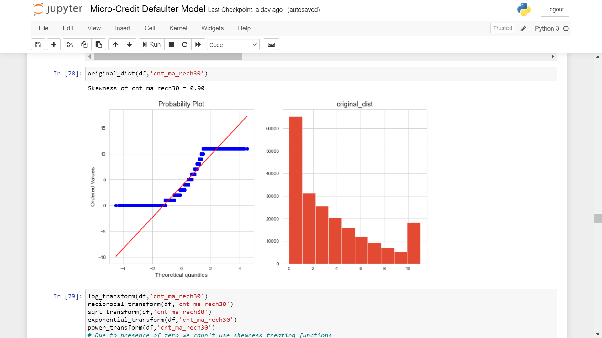

Slide 24
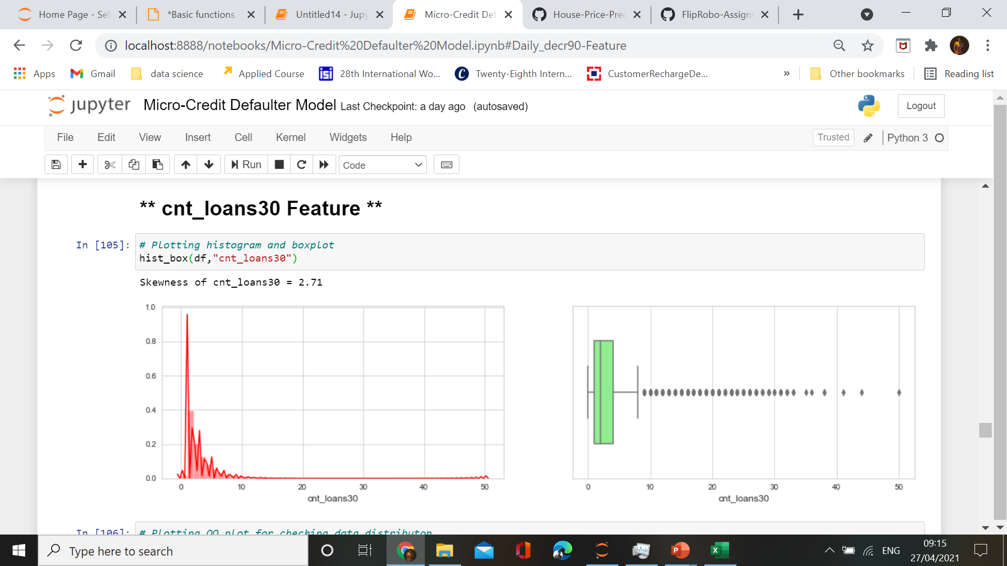
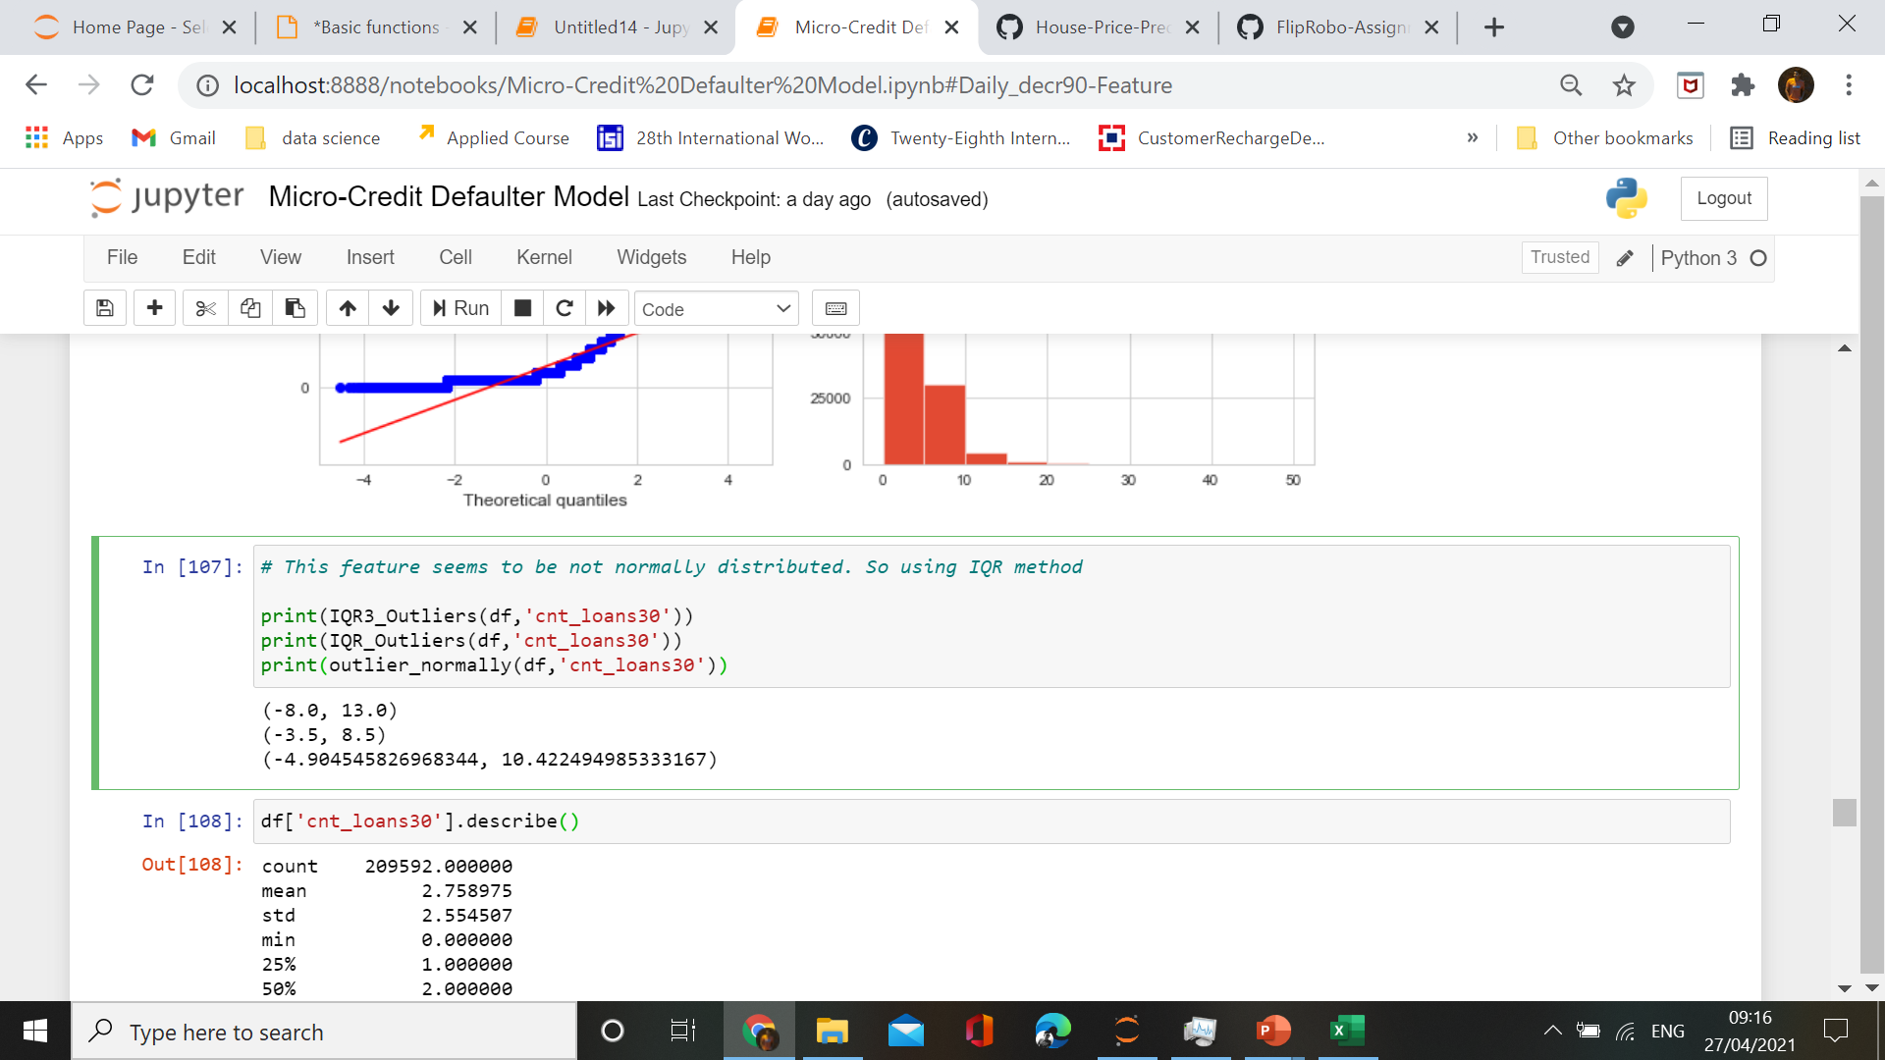
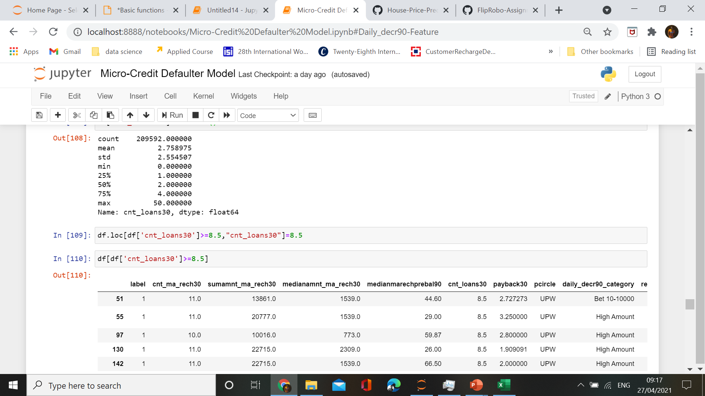

Slide 25
Model – Preprocessing and Model Training

Slide 26
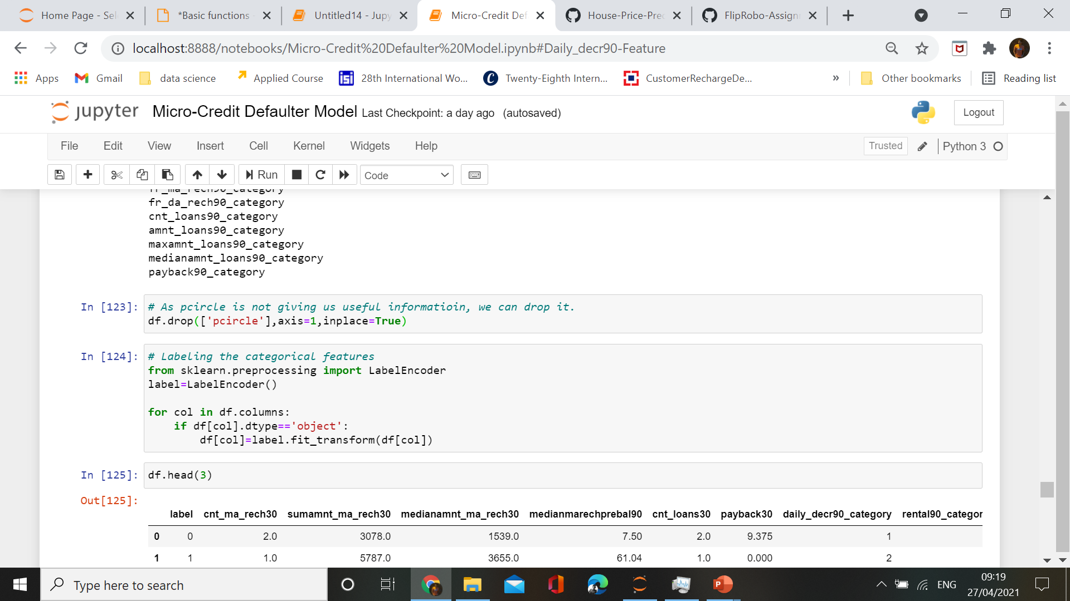
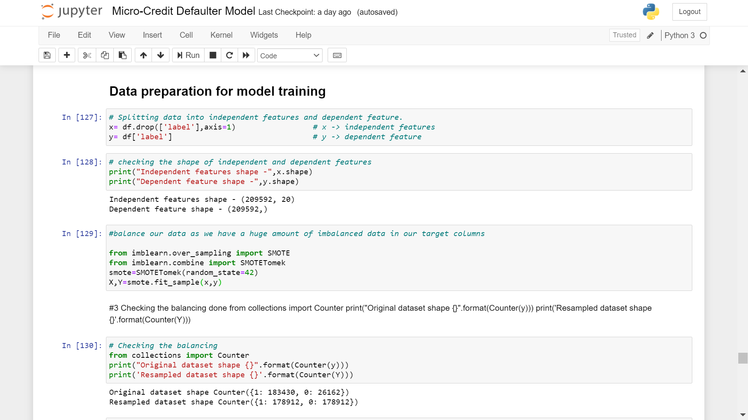
Labeling and splitting the data

Slide 27

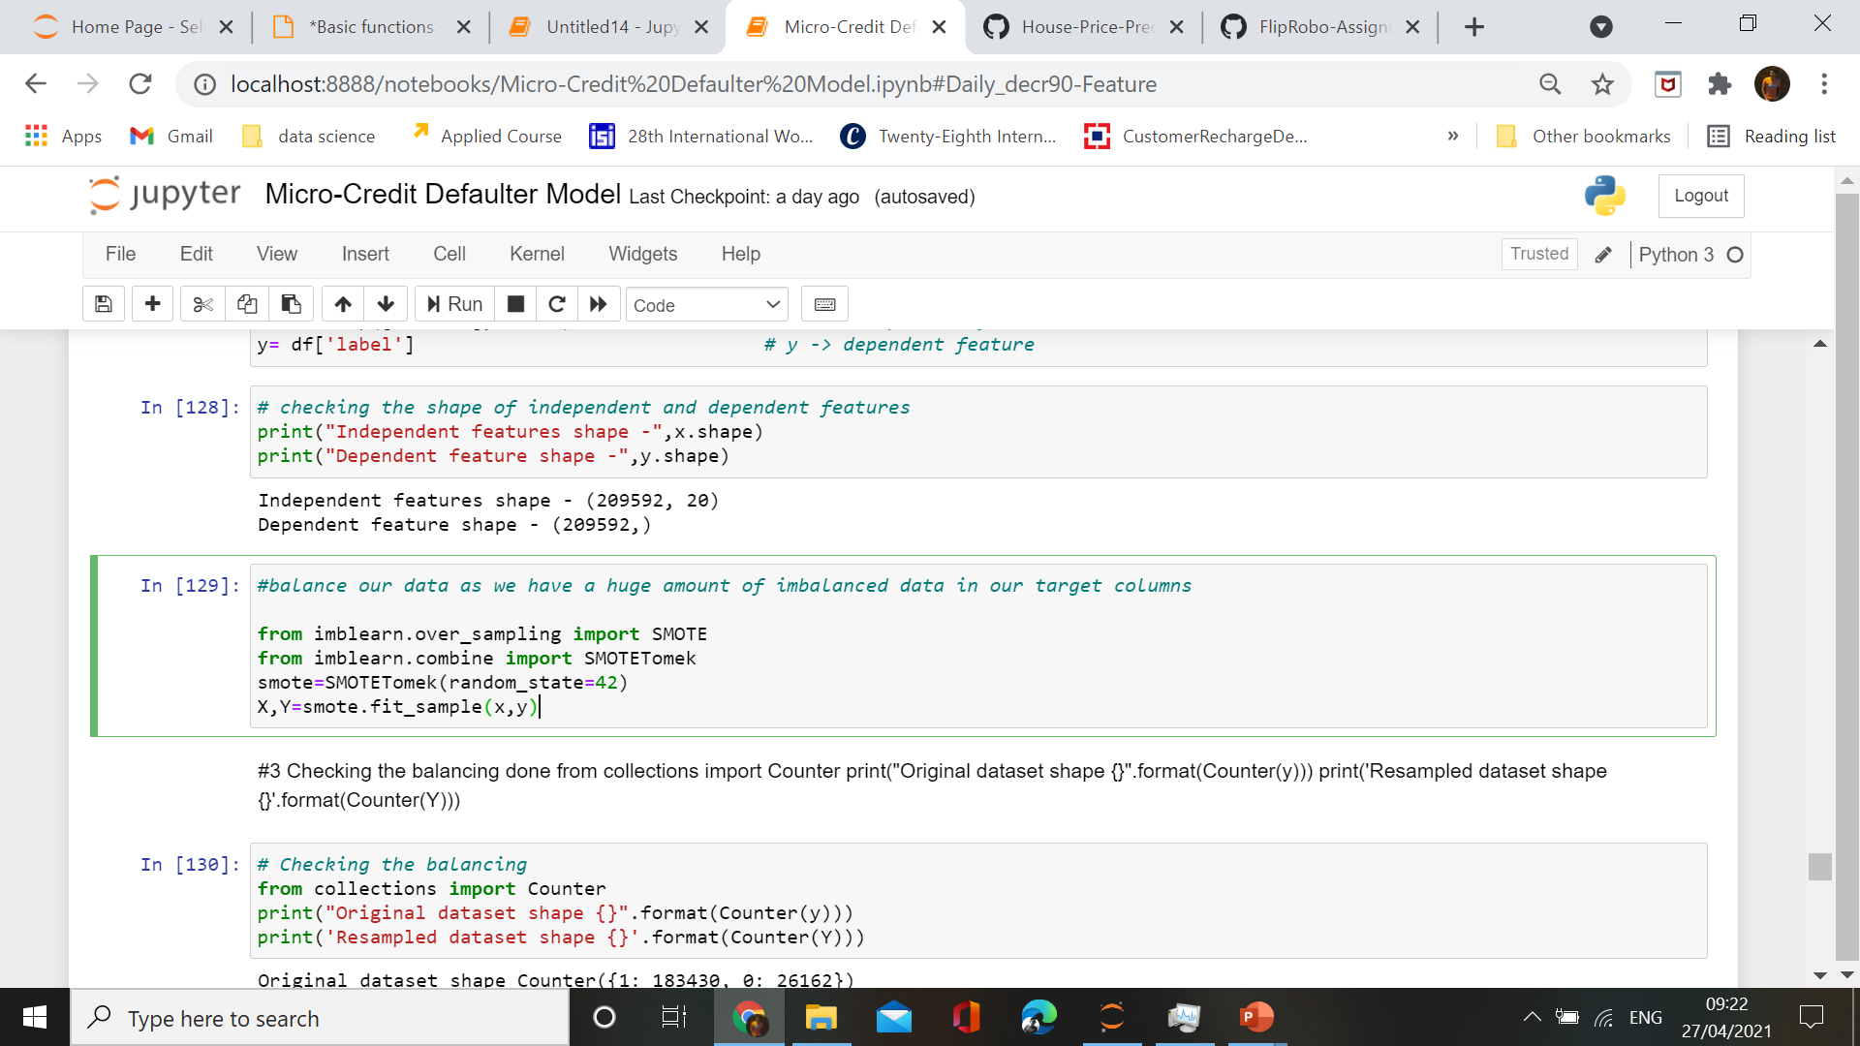
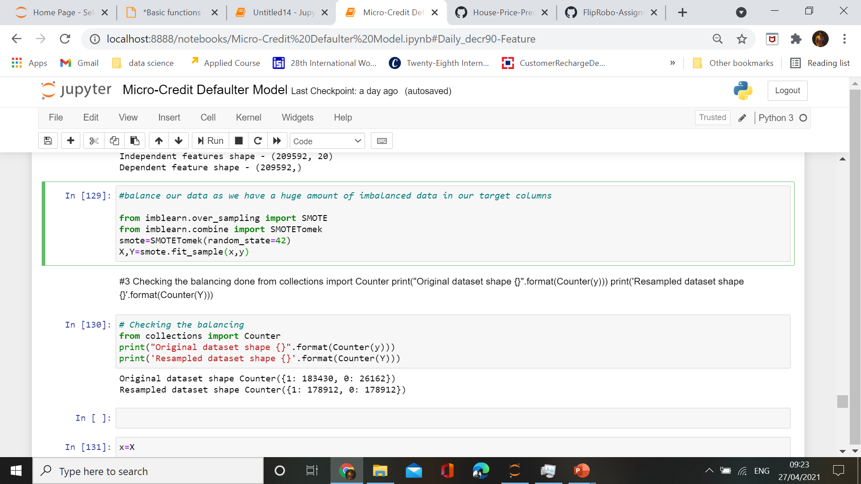
Balancing the data

Slide 28
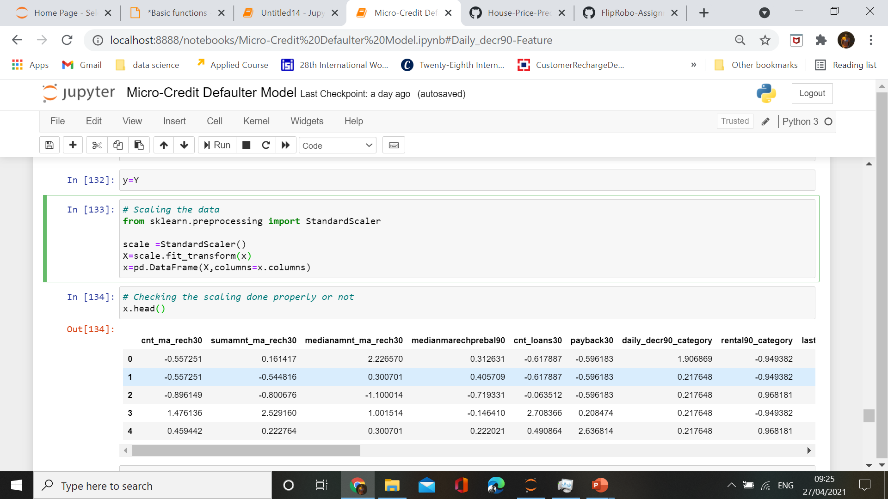
Scaling the data

Slide 29

Choosing a model
By data-preprocessing and data-analysing ,we came to conclusion that we need supervised machine learning model for our dataset prediction.
As our target data is discrete in nature ,which states that we need to choose classification models for our model building.

Slide 30
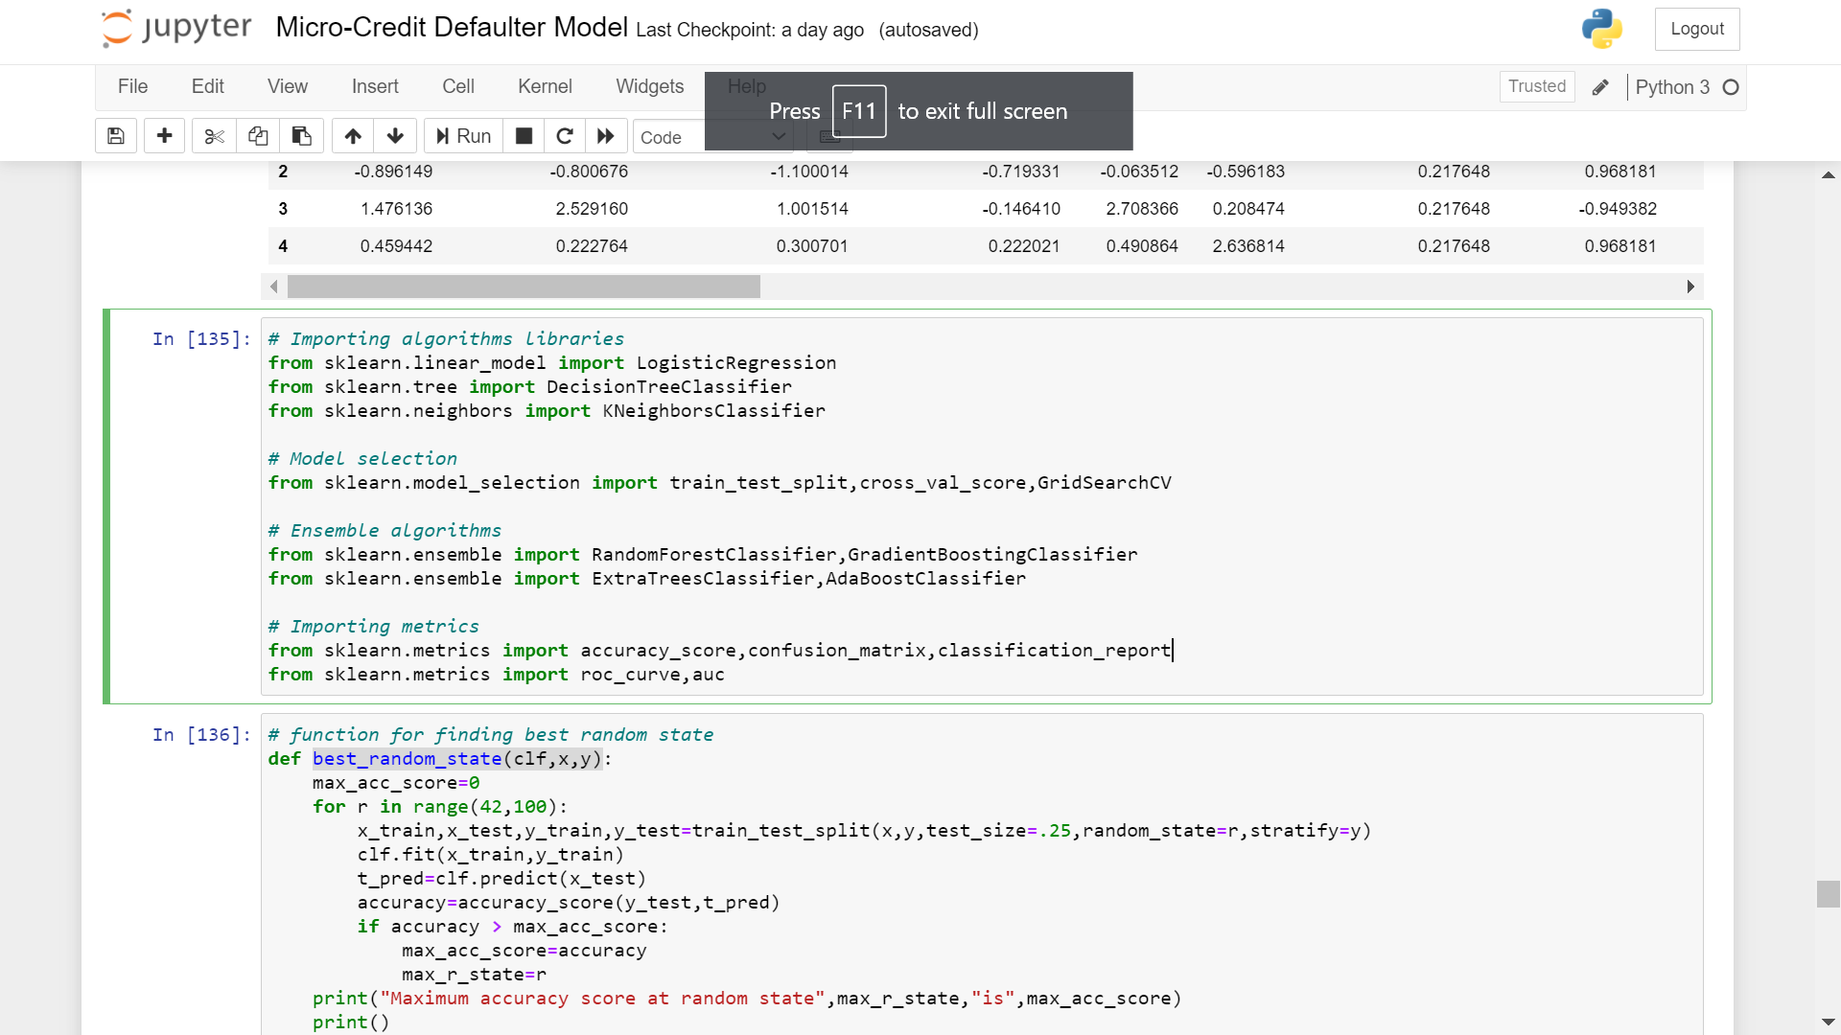
Importing libraries for model building

Slide 31
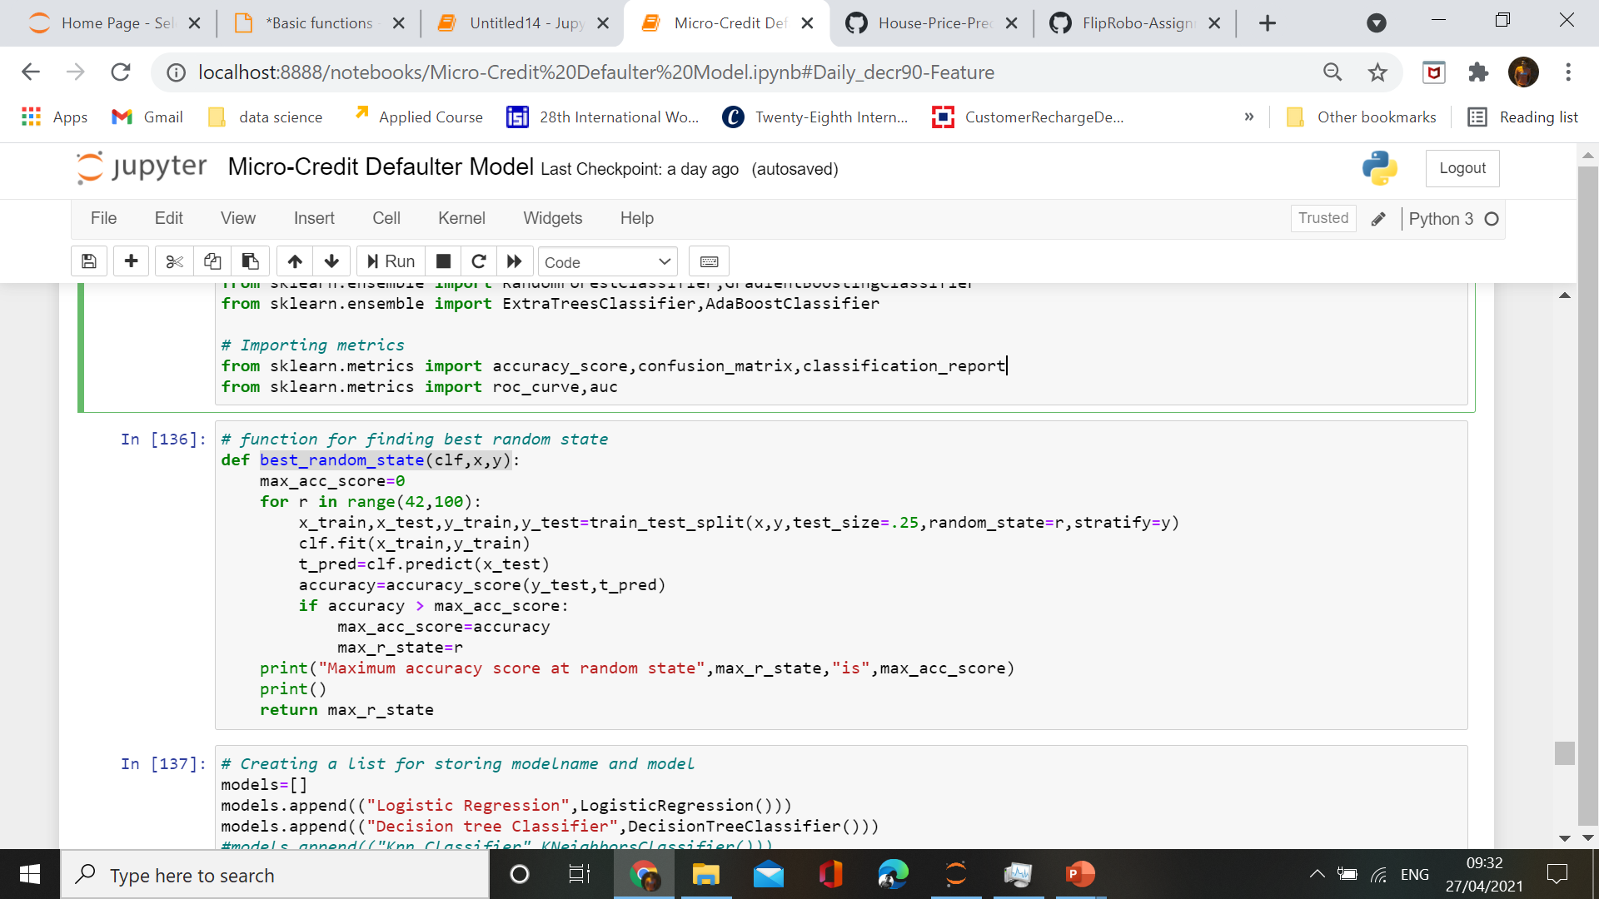

Slide 32
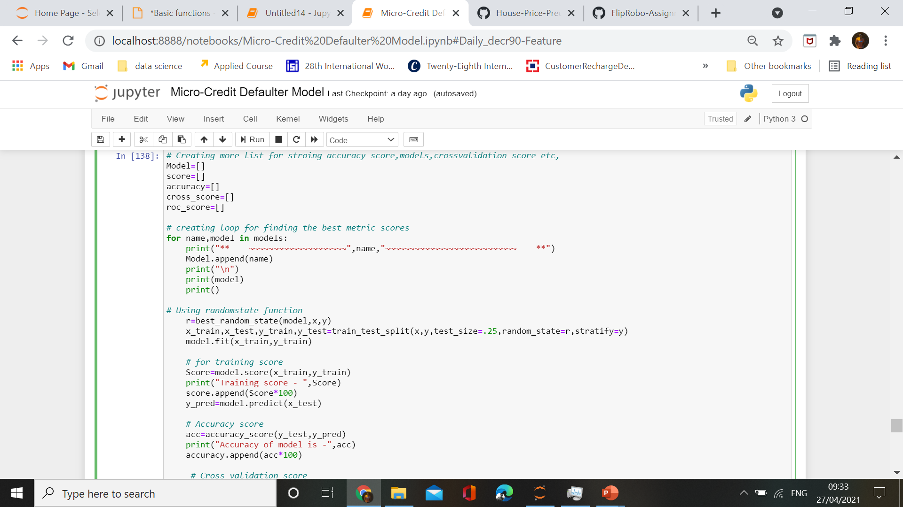

Slide 33
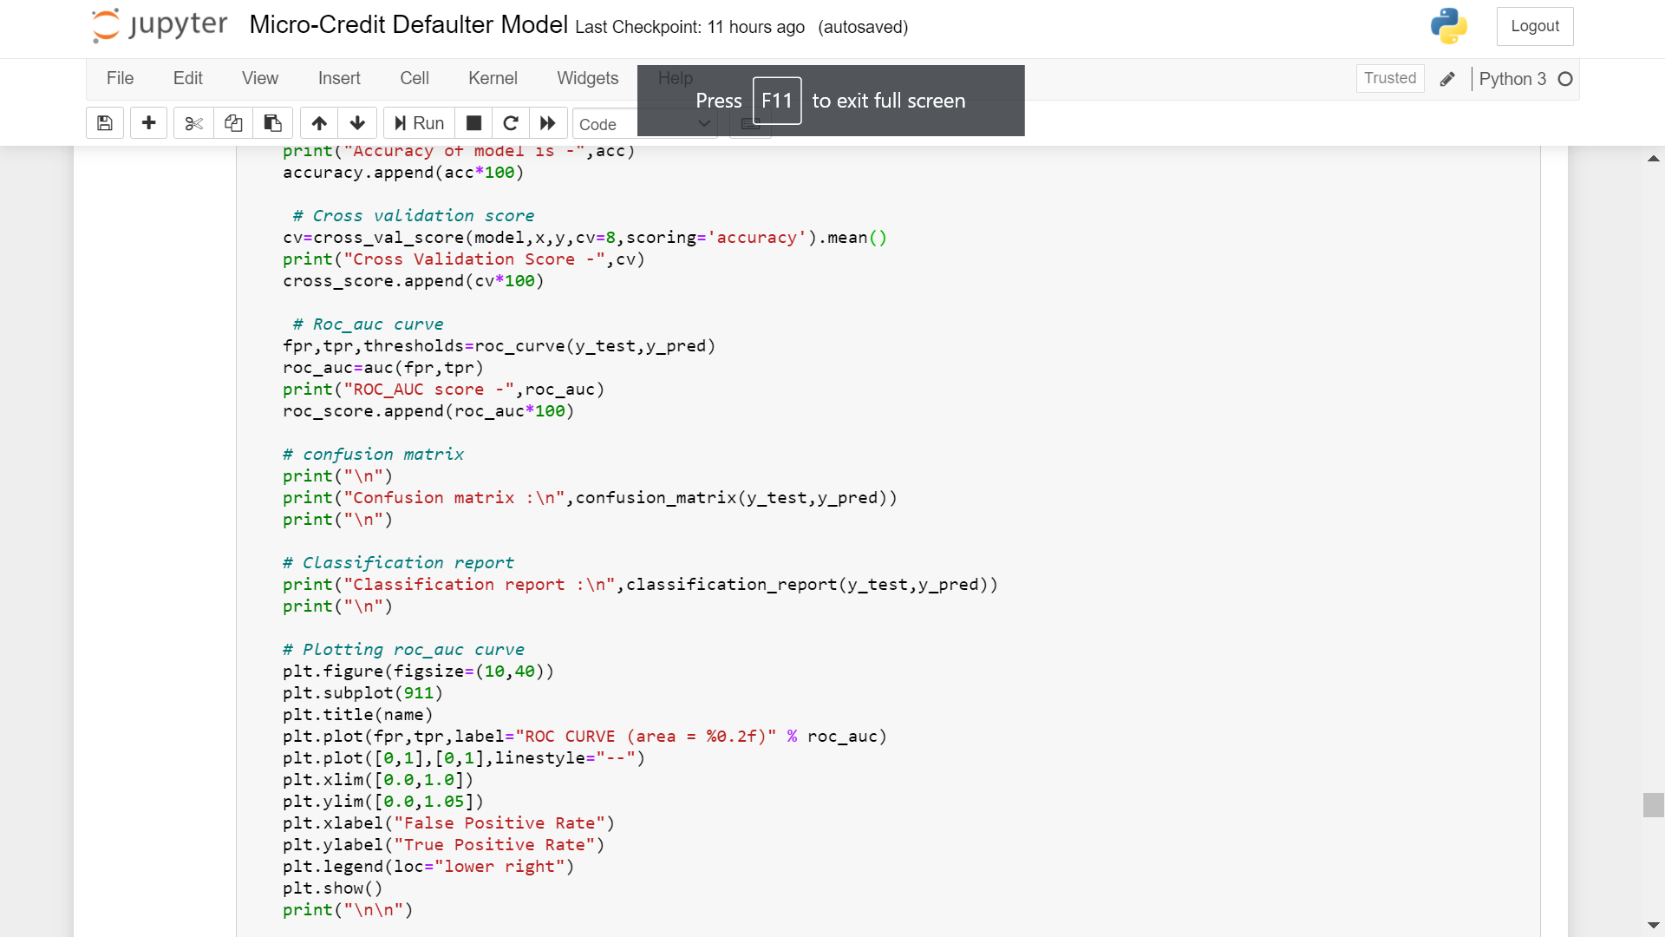

Slide 34
Machine learning Algorithms
Here we are using following algorithms:
Logistic Regression
DecisionTree Classifier
RandomForest Classifier
GradientBoosting Classifier
ExtraTrees Classifier

Slide 35

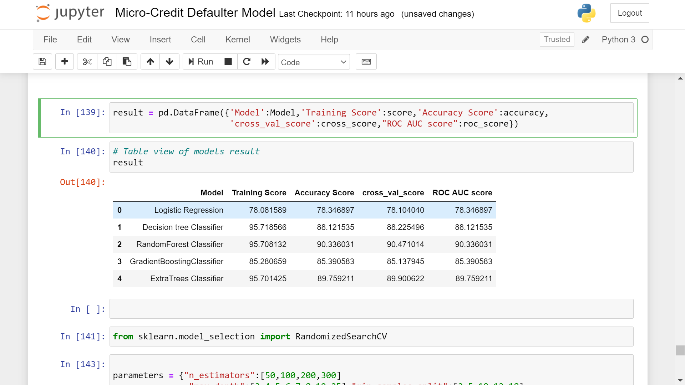
Summary of algorithms
Checking the summary result ,we find out that RandomForest Classifier and ExtraTrees Classifier are behaving better than others in all metrics.

Slide 36
Model Evaluations

Slide 37
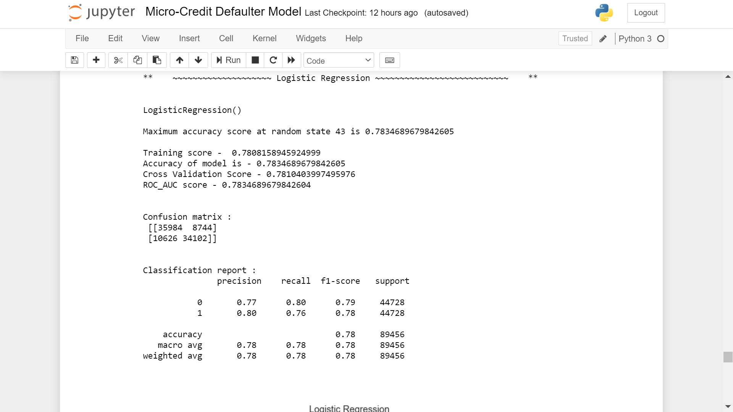
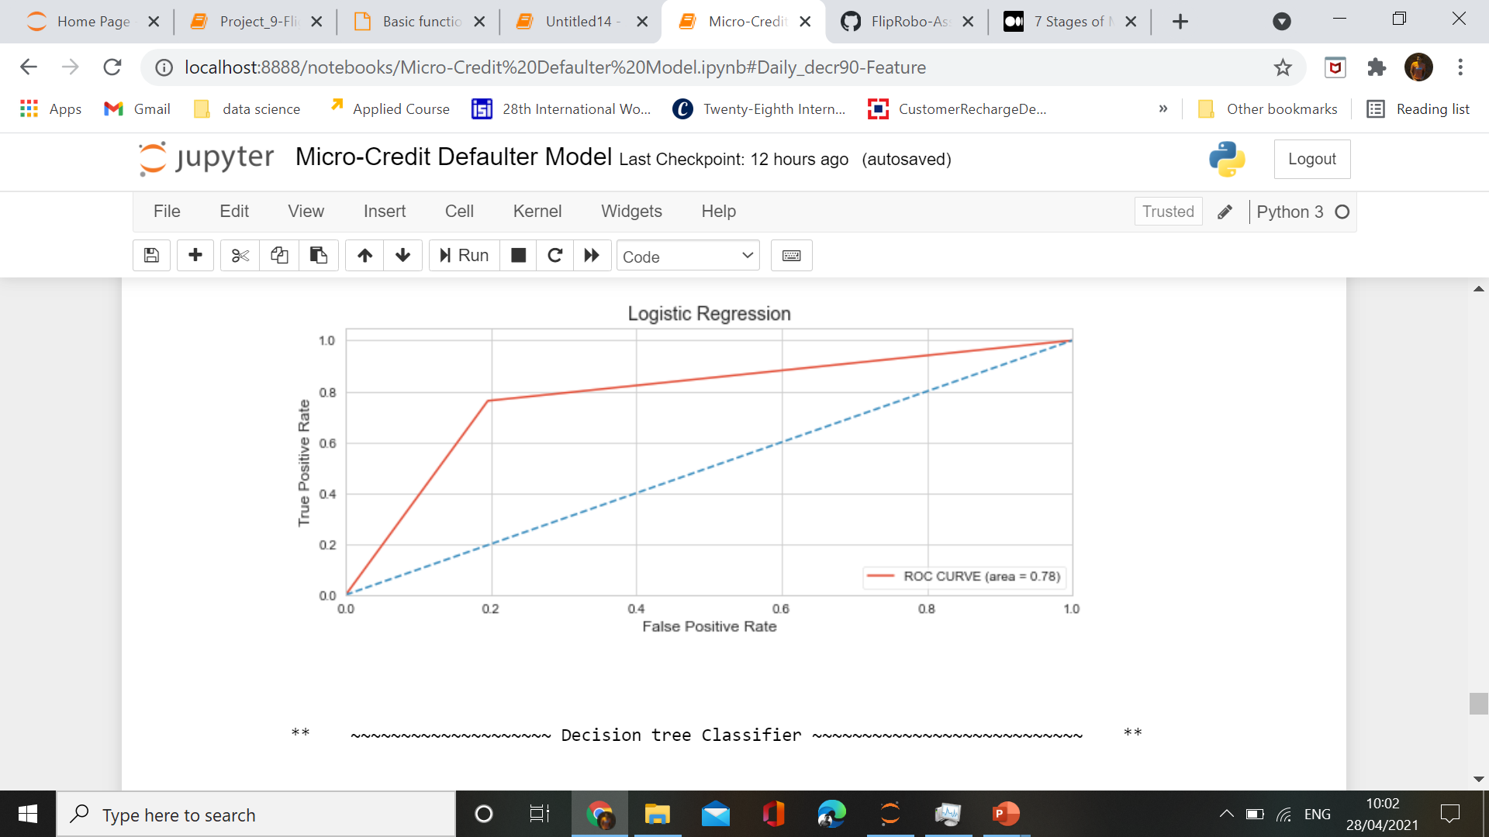
Logistic Regression
ROC_AUC CURVE

Slide 38
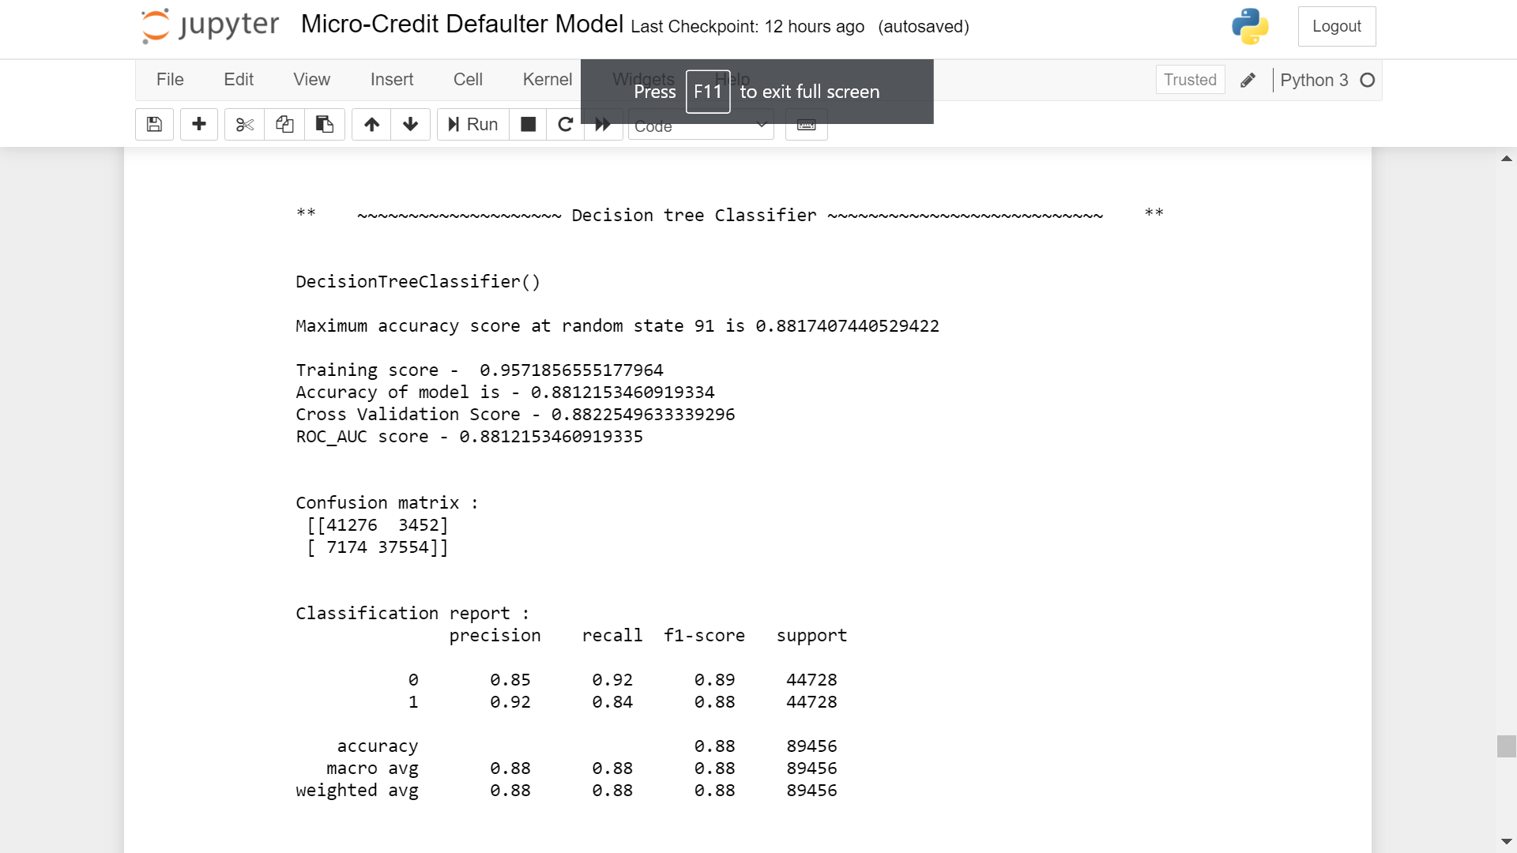
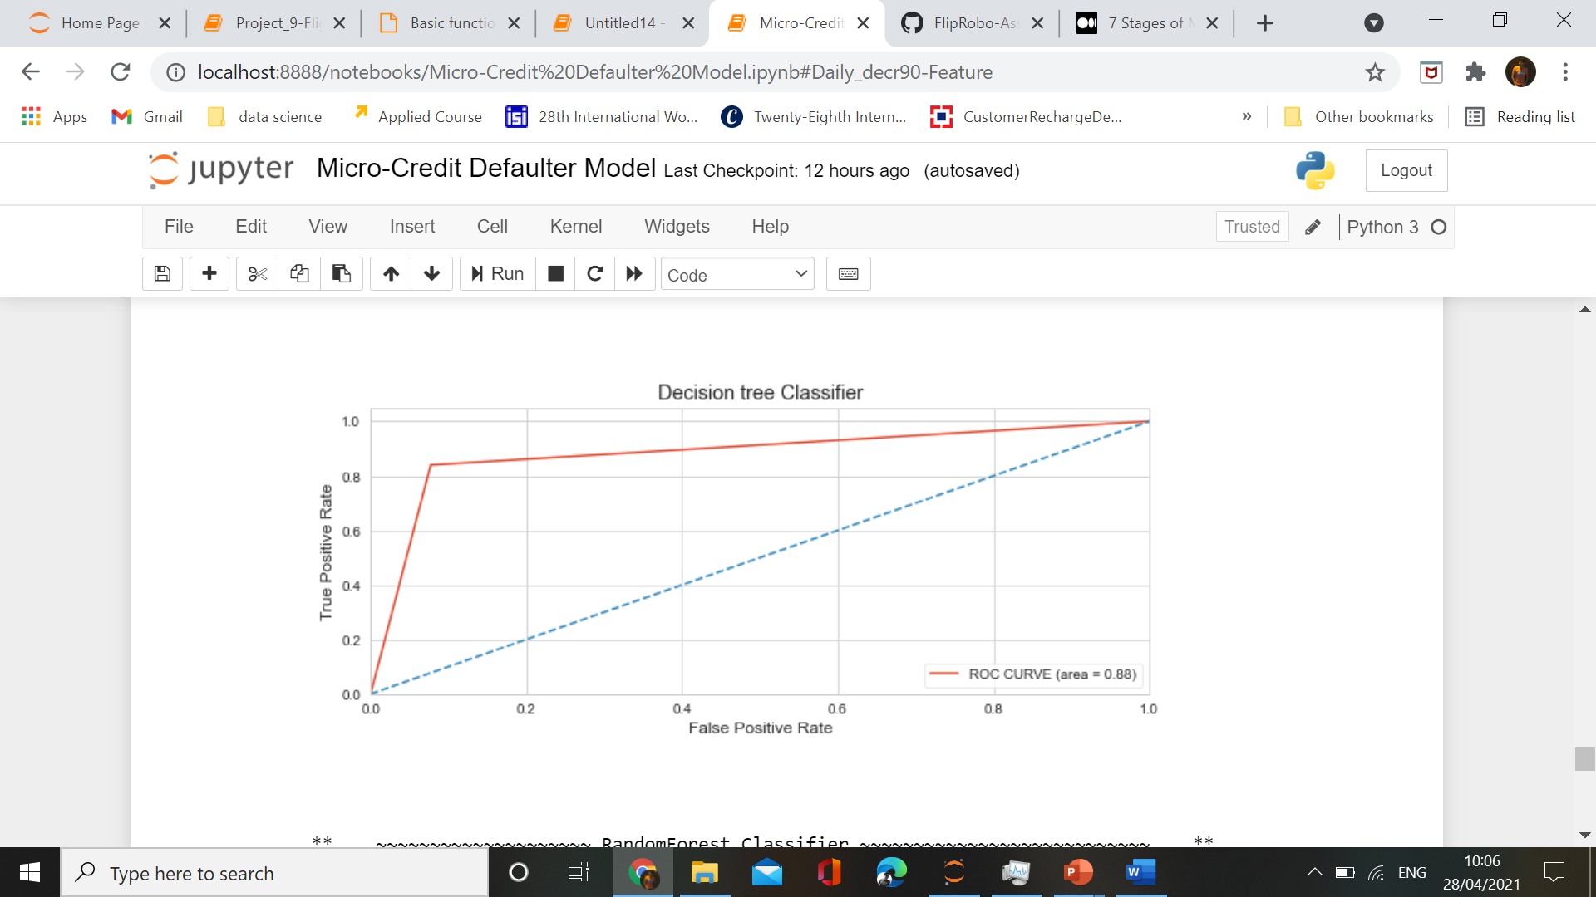
DecisionTree Classifier
ROC_AUC CURVE

Slide 39
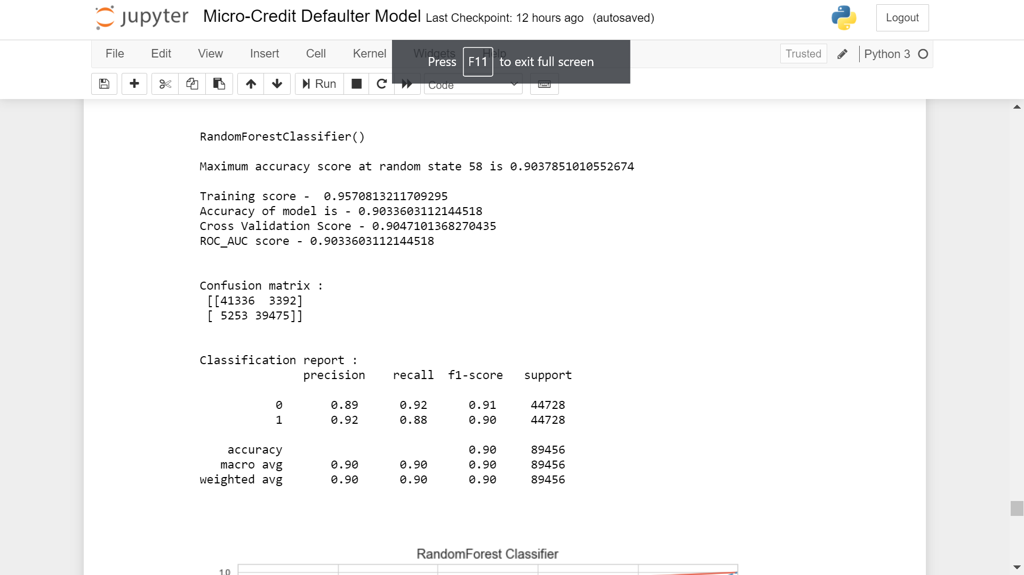
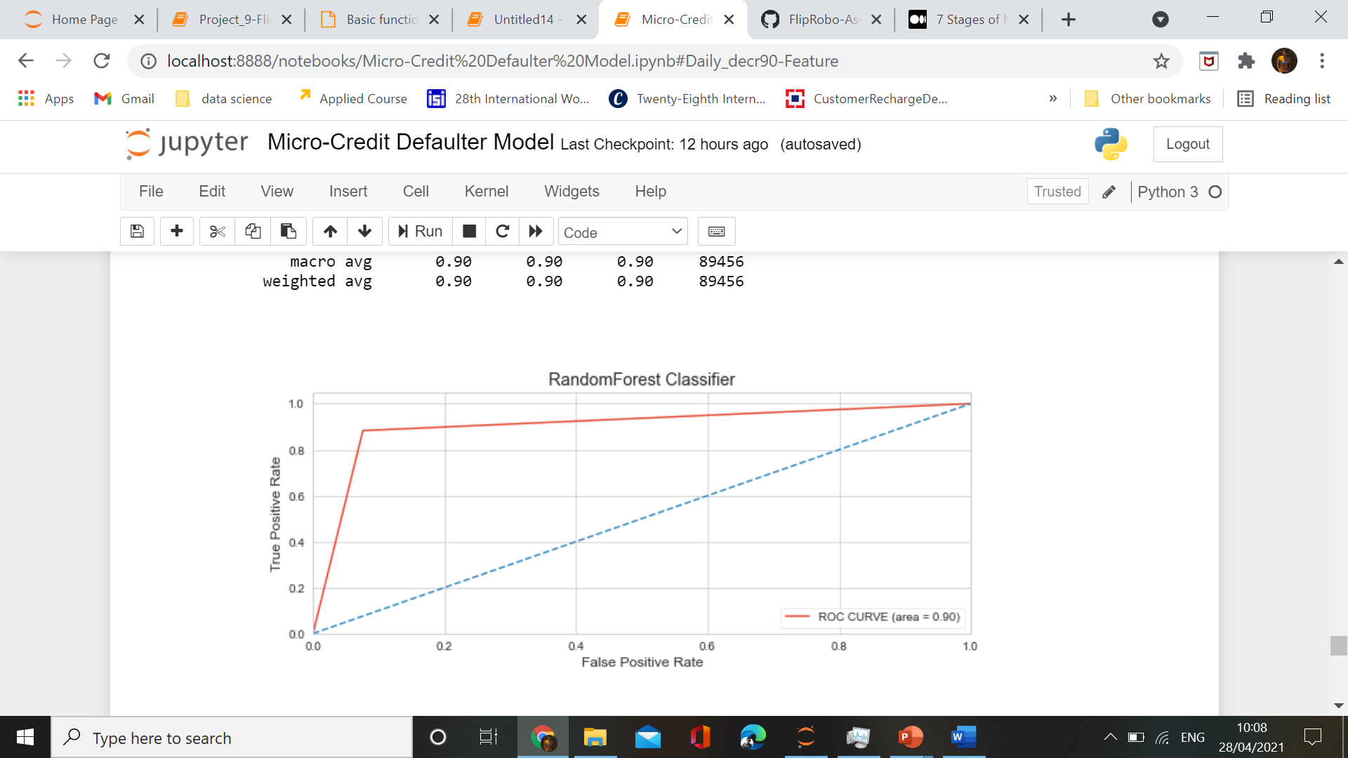
RandomForest Classifier
ROC_AUC CURVE

Slide 40
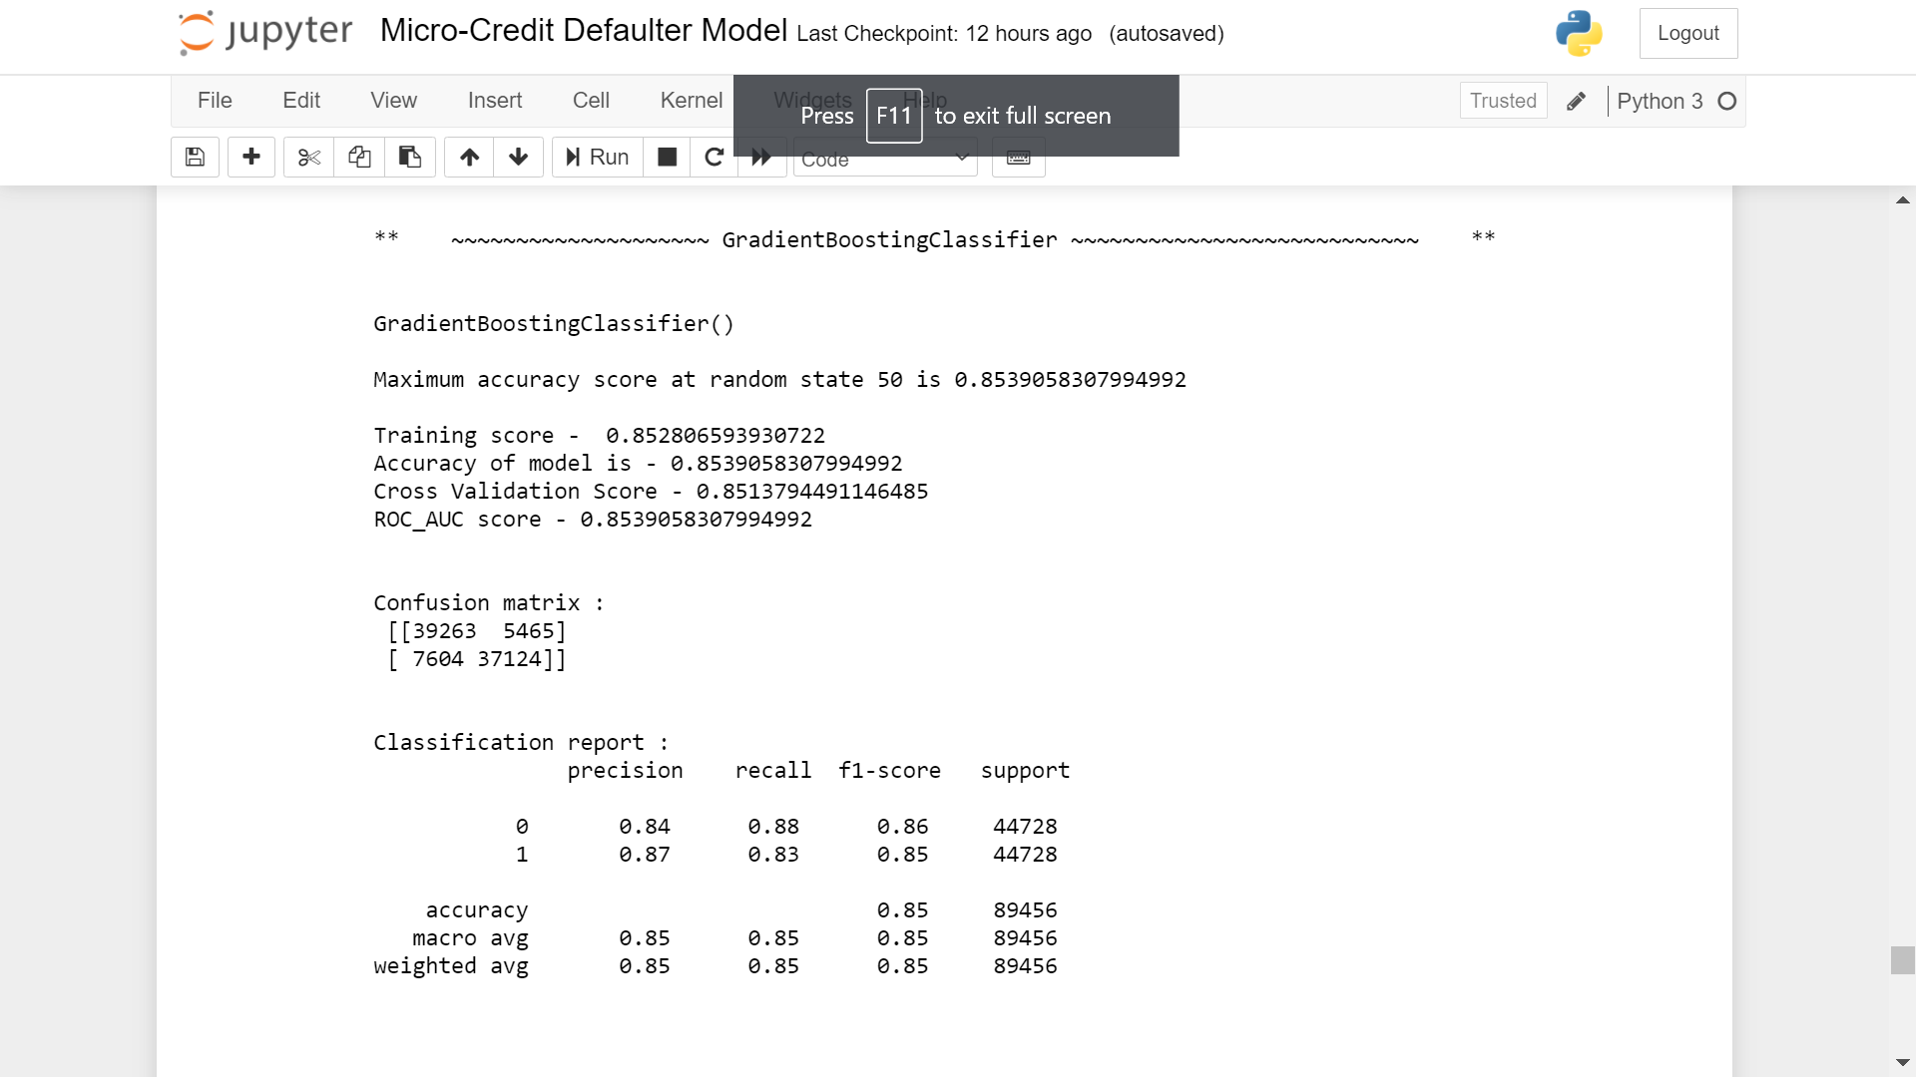
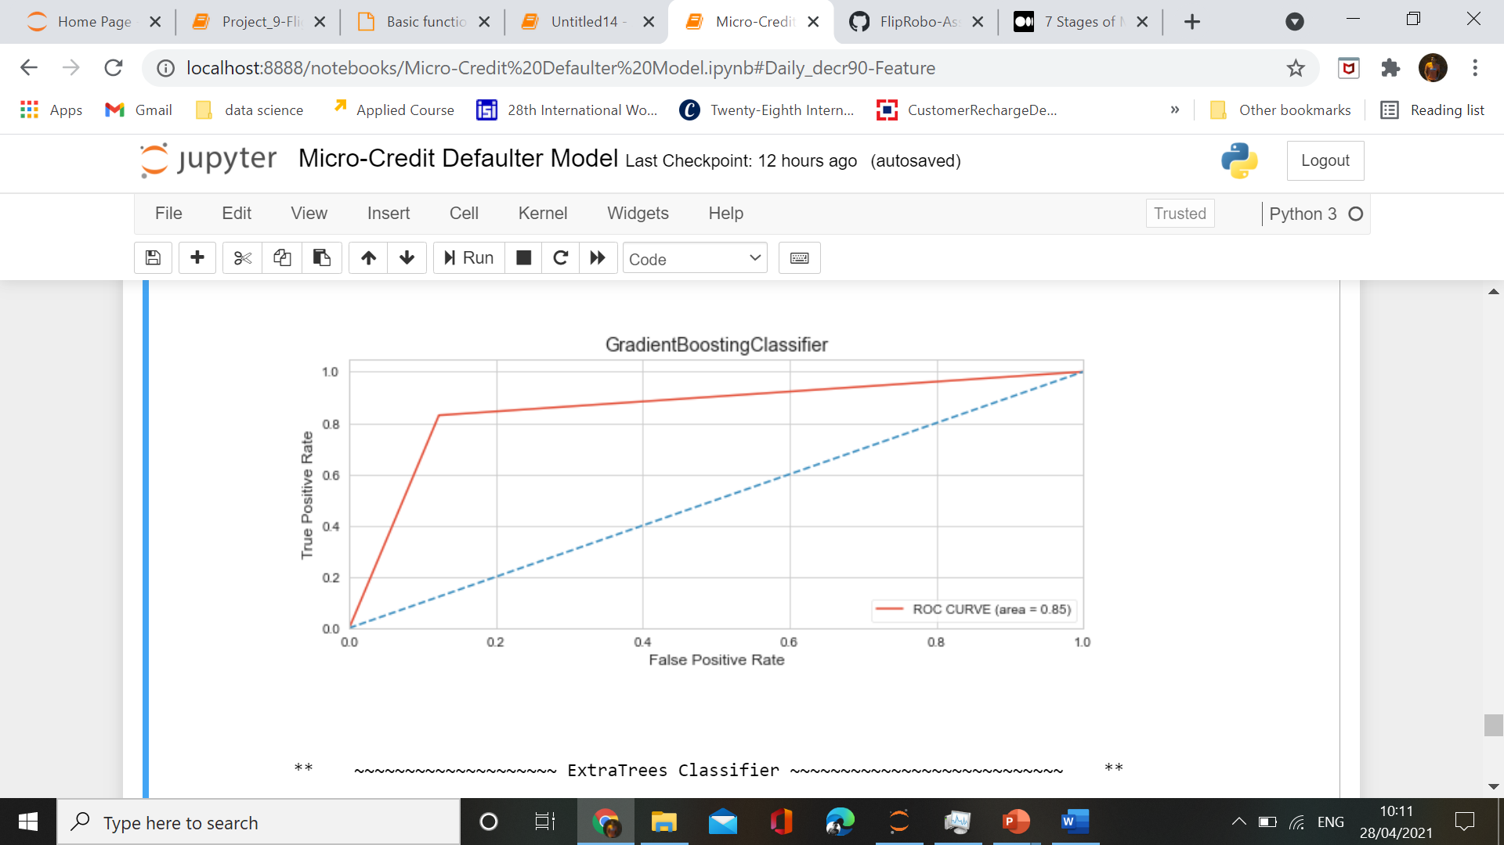
GradientBoosting Classifier
ROC_AUC CURVE

Slide 41
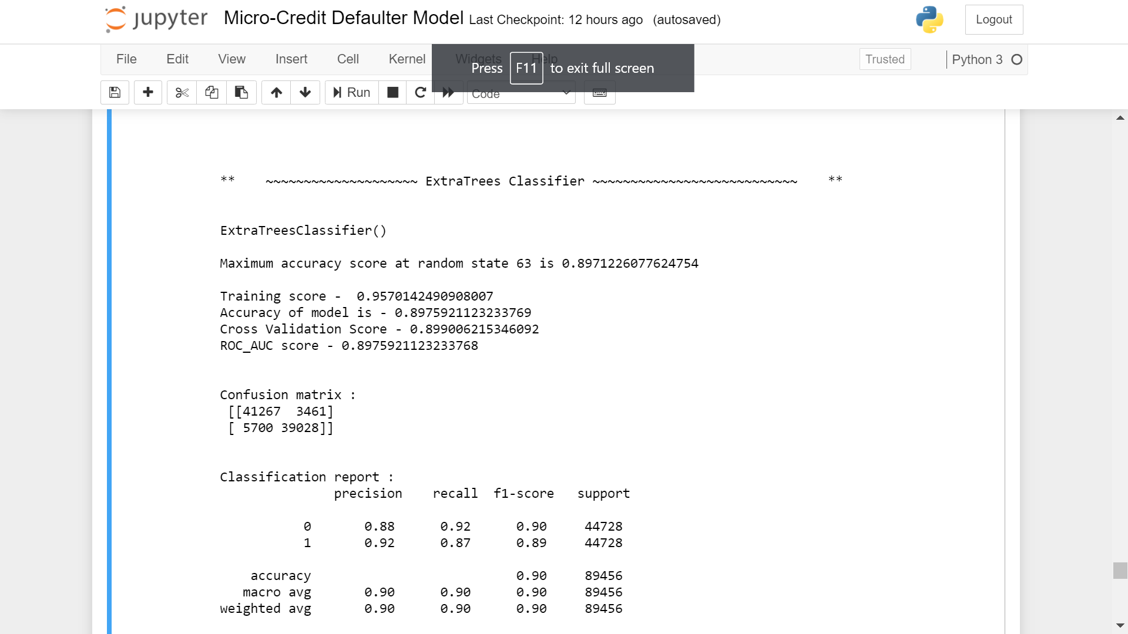
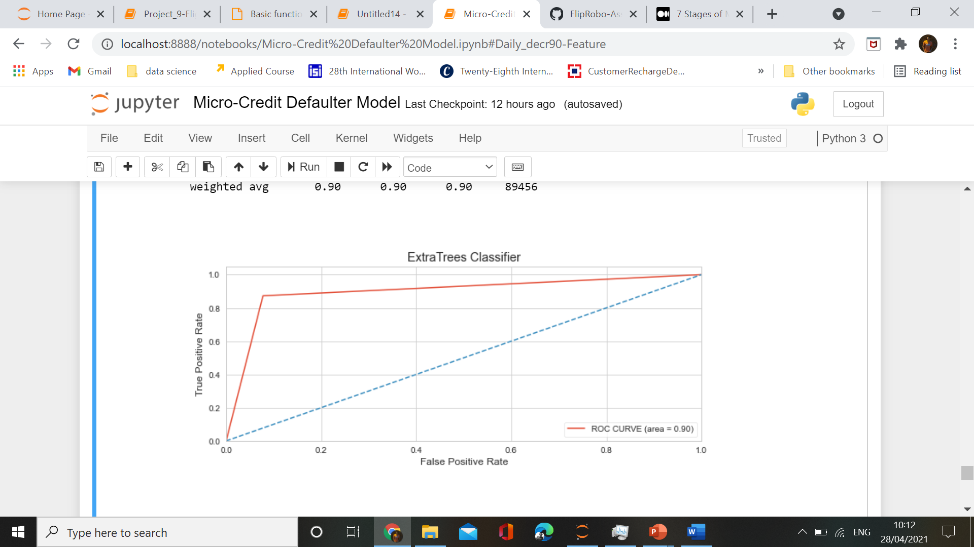
ExtraTrees Classifier
ROC_AUC CURVE

Slide 42
Hyperparameter Tunning
Using RandomizedSearchCV for the hyperparameter tunning of best algorithms.

Slide 43
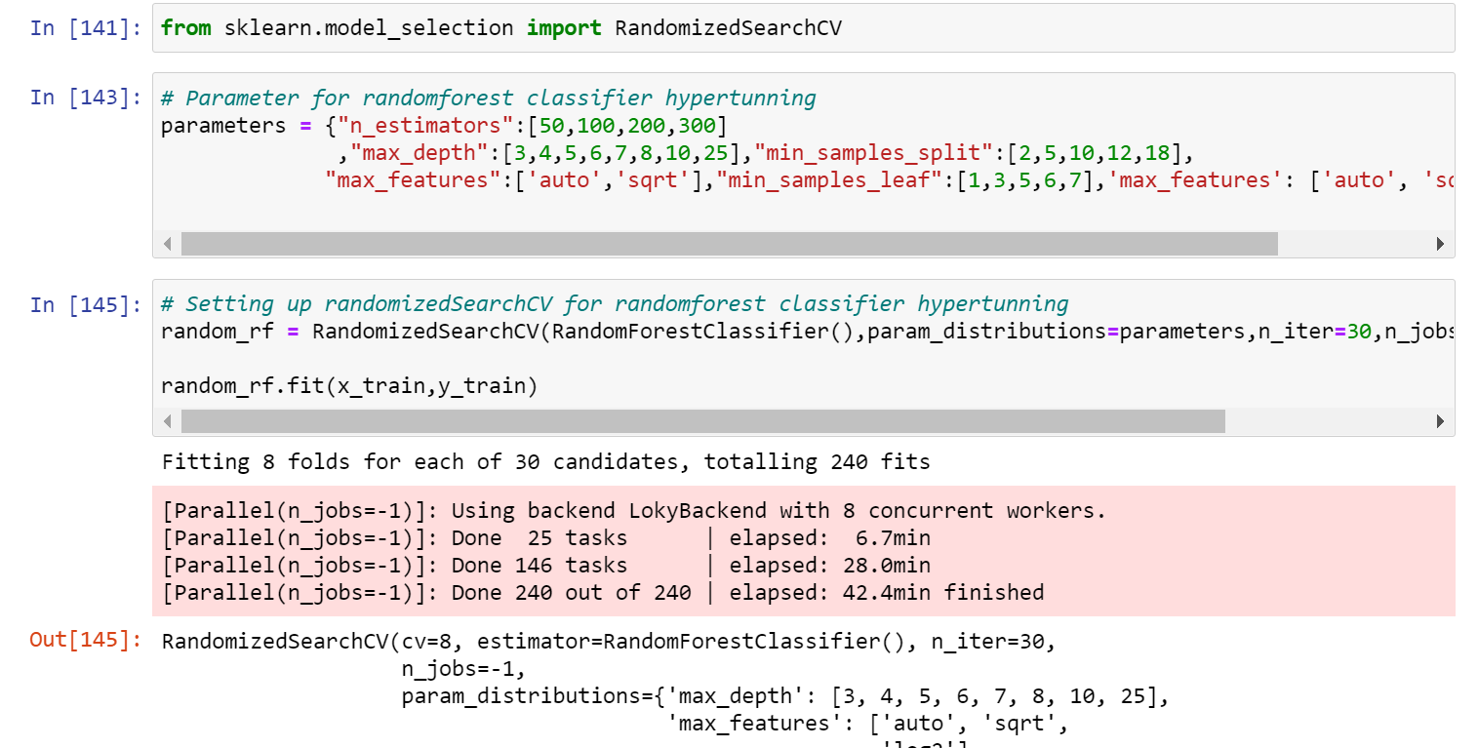
RandomForest Classifier Hyperparmeter tunnning

Slide 44
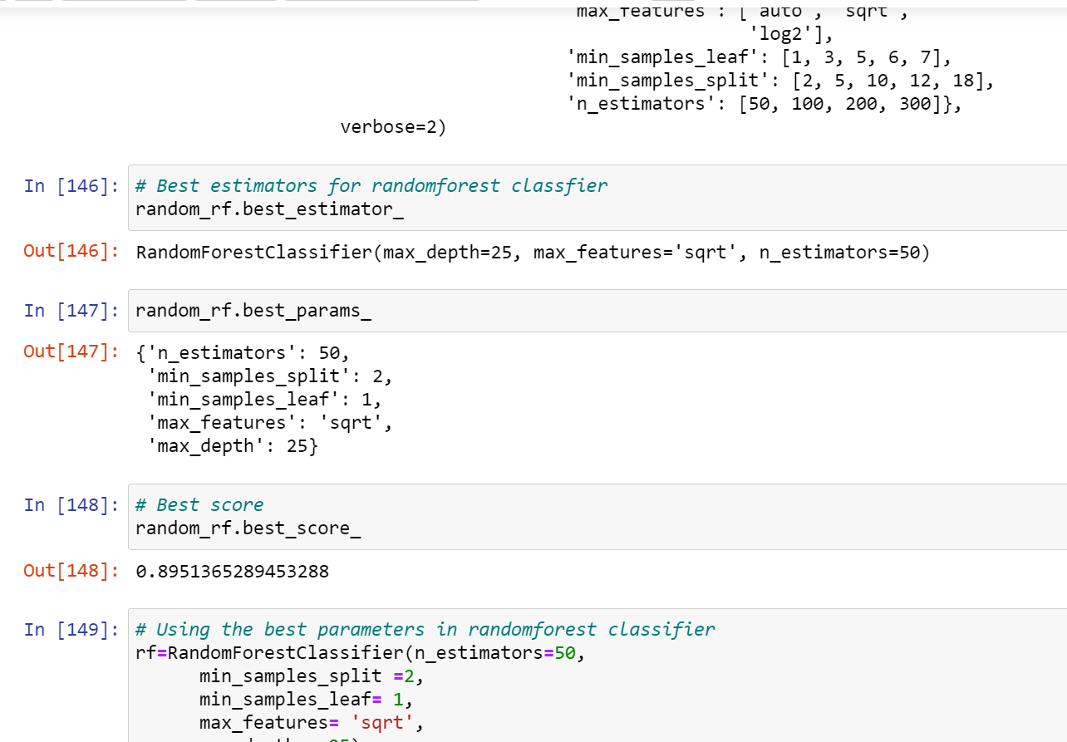

Slide 45
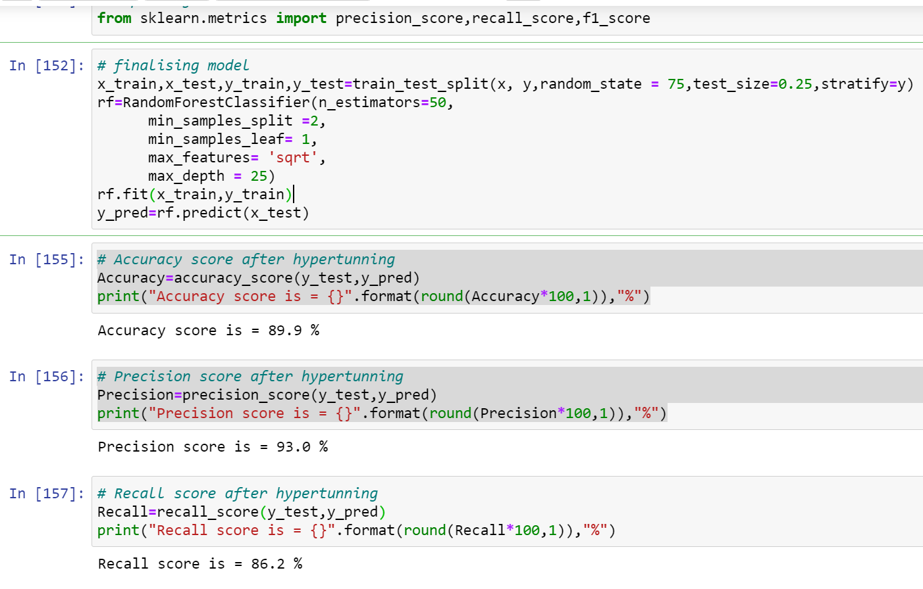

Slide 46
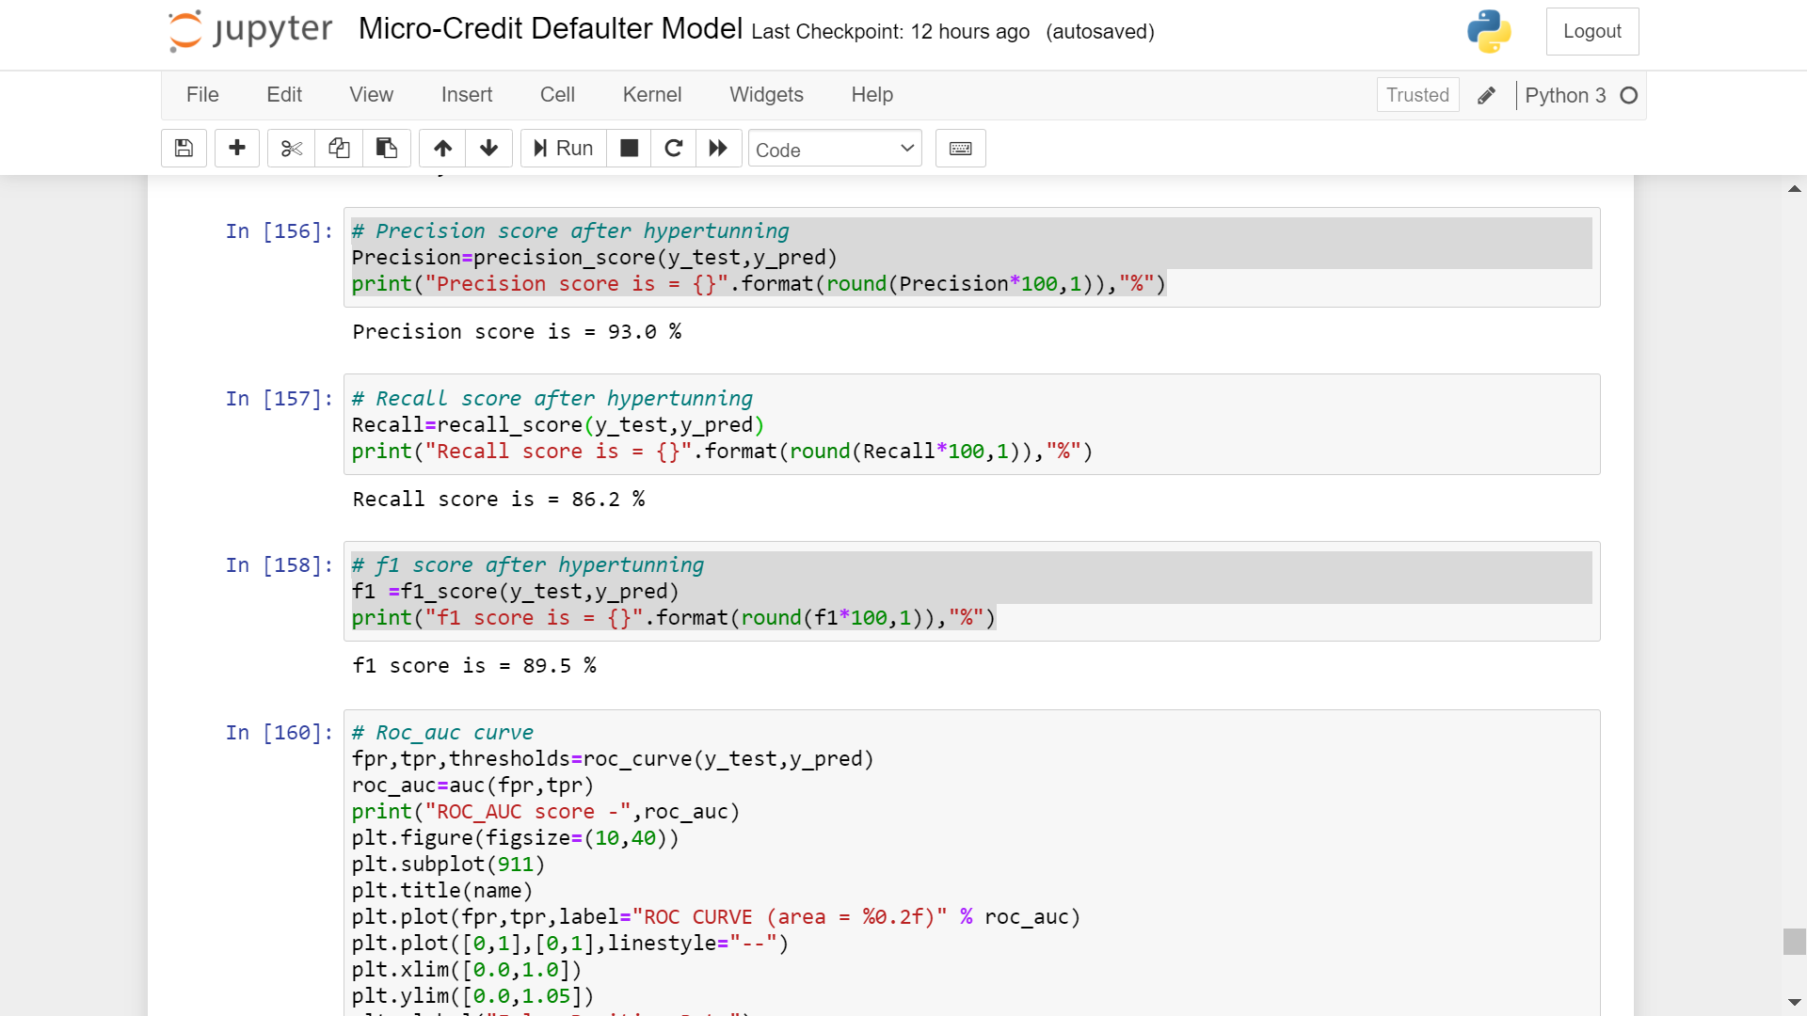
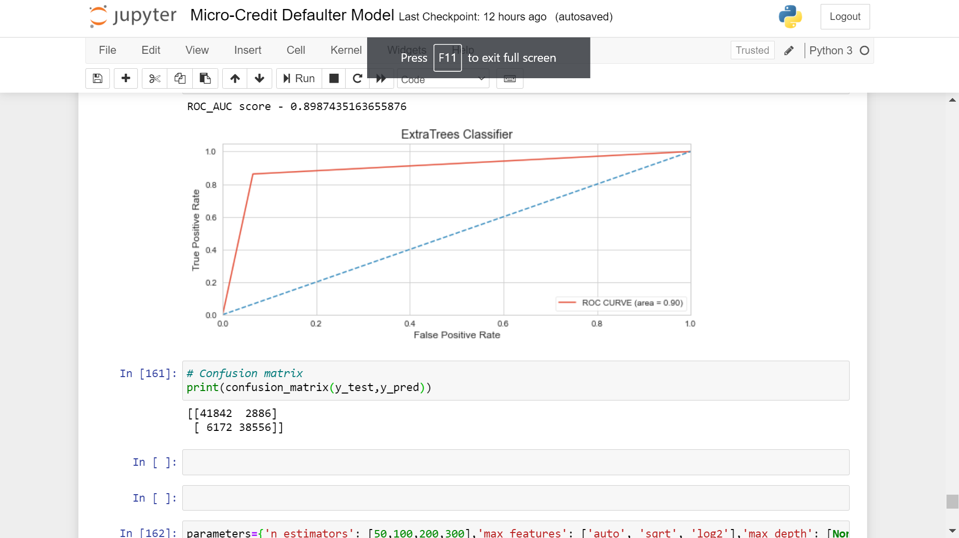

Slide 47

Model Prediction

Slide 48


Saving the prediction into csv file

Slide 49

Saving model

Slide 50


Conclusion of the project

Slide 51
Limitation and future scope
The major limitation in dataset I faced was presence of lots of outliers and as data was expensive I couldnot drop it and with those outliers my analysis is not very accurate.
We could use other algorithms also ,which may give better results,but due to inefficiency of my system,i can’t do that.
There are a lot of other techniques like feature_importances,higher hyperparameter tunning using GridSearchCV ,to retrieve better results.
This model will help my client in signify the difference between defaulters and non-defaulters and also helps in improvement of business in selection valuable customers.

Slide 52


